Slide 1
State of Education Update Budget, Policy, & Politics
September 2022

Slide 2
overview
Budget
Politics
ODE & State Board of Education Update
Statehouse Update
Policy
Recently Enacted
Lame duck session (post November election)
ITC & ESC-Led Initiatives
Discussion

Slide 3
State Budget update
Notes:
State finished the fiscal year with revenues nearly $2 billion above estimates.
Positive effect on OBM budget guidance to agencies for the 2024-2025 state operating budget.
Temper expectations for the next budget, however. Fears of a looming recession and healthy cash balances due to federal stimulus may not result in additional funding for K-12 education.
Governor DeWine continues to emphasize desire to invest in Student Wellness and Success initiatives.
ODE/State Board adopts preliminary budget recommendations will have final vote October 2022 meeting.
Budget recommendations are focused on results an outcomes
Focus on literacy - Deploying literacy coaches in low-performing schools, Incentivizing the use of high-quality instructional materials, encouraging teacher PD in the science of reading

Slide 4
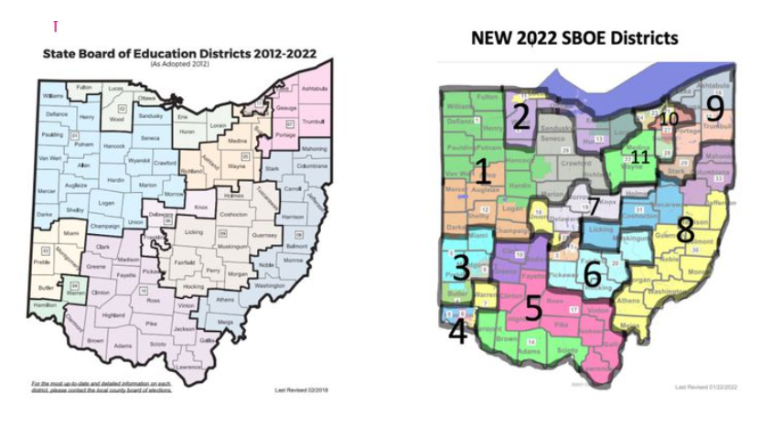
ODE Update - State Board of Education
Elections
State Superintendent Search
HB 298 – Remove appointed members
Has bipartisan support
Notes:
Ohio has 19 state board of education districts: 11 elected and 8 appointed by the governor. Each elected seat is comprised of 3 Ohio Senate Districts. Elected Members serve staggered terms and five seats are up this year – Regions 2, 3, 4, 9, 10
Gov. DeWine redrew the 11 districts Jan. 31 using a Jan. 24 map the Ohio Supreme Court one week later found to be unconstitutional. But DeWine didn’t change those districts, which today no longer reflect the boundaries of the state Senate districts being used for the 2022 elections.
So, when we get to 2024, we clearly have a problem…the State Board of Education districts will be redrawn again, this time to reflect approved Senate Districts. Will that mean that some board members’ districts overlap, in turn excluding some Ohioans from representation on the State Board of Education? Or, will the state in 2024 have to decree new boundaries for already-elected board members?
Some have argued that violates Ohio law, which requires that each education district “shall consist of the territory of three contiguous senate districts” and prohibits dividing senate districts among different education districts.

Slide 5
Ohio Department of Education
Notes:
Overcoming Obstacles to Learning (Learning Recovery)
Accelerating Learning
Preparing Students for Future Success (College and Career Readiness)

Slide 6
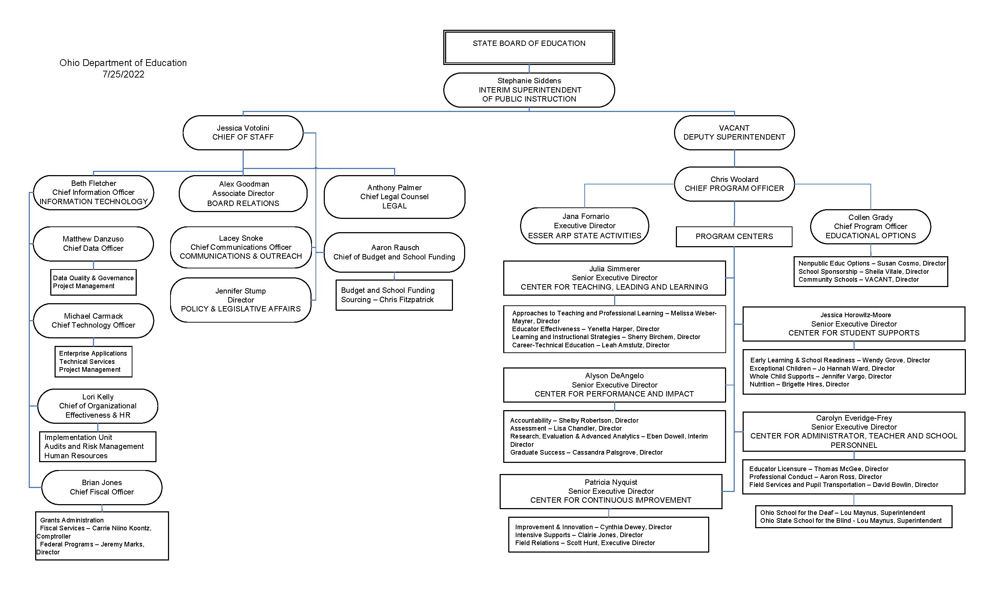
Ohio Department of Education
Notes:
Overcoming Obstacles to Learning (Learning Recovery)
Accelerating Learning
Preparing Students for Future Success (College and Career Readiness)

Slide 7
Ohio General Assembly
Primary Elections
General Election
34 Uncontested Seats
Notes:
Turnout for the August Primaries was historically low: <10%. It was the state’s second primary dealing only with state legislative and central committee races.
But May Primary was only 20.8% statewide.
3 Incumbents changed: 2R 1D.
25% of the seats in the General Assembly are uncontested in November.

Slide 8
statehouse update

Slide 9
General Assembly
The legislature has been recessed for the summer since early June
Due to issues with the new legislative district maps, statehouse Primary election was on hold
Unusual August 2nd Primary
While some “as-needed” sessions are scheduled in September and October, the legislature may meet again until after the November General election
Meanwhile four House members have announced they are vying for the role of Speaker of the House in the next General Assembly which begins in January 2023
The Lame Duck session for the current General Assembly is expected to be active given the lack of action over the past several months

Slide 10
Recently Enacted legislation

Slide 11
HB 583: Education “Omnibus” Bill
Substitute Teachers
School Finance
School Choice
Scholarships
Education Savings Accounts
Community Schools
Tutoring
Dyslexia Screening
Resident Educator
Notes:
HB583 into law on June 24th with an effective date of September 21, 2022. This bill was introduced originally to extend the permissive authority for school districts to set local requirements for substitute teachers. Prior to the bill’s passage, the Senate added a number of other provisions on miscellaneous topics, including the postponenment of Ohio’s new dyslexia screening requirments. (The Ohio Dyslexia Committee made some minor changes to the Dyslexia Guidebook at its June meeting to comply with the changes in HB 583.)
Provides the same substitute teacher flexibility as in the current year for the next two school years.
Removes the prorated reduction in the income-based EdChoice voucher amount when a voucher student’s family income rises above the 250% of the federal poverty level threshold. Once a student qualifies for the income-based voucher, they will always qualify, regardless of income as do their Siblings
Afterschool Child Enrichment voucher will retain unused funds in their educational savings account for use in future years until the student graduates.
Implements the statewide tutoring program as proposed in SB 306.
The provision in SB 306 which would have required all ESCs to help with the placement of tutors for any district in their service area was made “permissive” in the final version.
Makes changes to Ohio’s new dyslexia laws including:
Postpones the requirement to begin screening students for dyslexia to the 2023-2024 school year, however, it expressly permits districts to implement early.
Clarifies that districts comply with the “statutory” requirements related to the dyslexia guidebook and makes clear districts “may” utilize the best practices contained therein.
Exempts Physical Education, Music and Fine Arts teachers from the dyslexia-related professional development requirements.
Changes the term “course” to “training” related to the professional development requirements.
Removes the term “multi-disciplinary” from the law (leaves the term “structured literacy”).
Allows (for five years beginning July 1, 2023) individuals to obtain an alternative resident educator license in any subject area (current law has limitations).

Slide 12
Pending legislation

Slide 13
HB 151: Ohio teacher residency
After laying dormant for almost a year, HB 151 was overhauled and passed by the House in June.
Originally introduced to replace the Ohio Teacher Residency (OTR) program with a new Mentoring program, the House Education Committee revised that intent.
Substitute HB 151 would retain the OTR and the Resident Educator Summative Assessment, but provide more flexibility for participants.

Slide 14
HB 151: Ohio teacher residency
The new bill would:
Create new options for online access to “highly qualified mentors”.
Permit participants who fail the assessment to meet with an instructional coach to review score results and discuss improvement strategies.
The assessment could be taken multiple times (no limit).
A participant’s observation of a veteran teacher would qualify for CEUs for license renewal.

Slide 15
HB 151: Interscholastic Athletics
Before passing the bill, it was amended on the House floor to include provisions from HB 61.
Schools would be required to to designate separate single-sex athletic teams based on the sex of the participants (also applies to OHSAA and college athletics).
If applicable, coed teams would be required.
Authorizes athletes to file a civil action if deprived of an athletic opportunity or suffers harm as a result of a violation of the bill, or experiences retaliation for reporting a violation.

Slide 16
HB 151: Interscholastic Athletics
If an athletic participant’s sex is disputed, the participant’s sex must be established through a signed physician’s statement. The physician must base the statement on only:
The participant’s internal and external reproductive anatomy;
The participant’s normal endogenously produced levels of testosterone;
An analysis of the participant’s genetic makeup.
Dubbed the “Save Women’s Sports Act.”
The bill has not yet been assigned to a committee in the Senate.

Slide 17
HB 333: School counselors
Requires ODE, within 120 days after the bill’s effective date, to make recommendations for a job description for public school counselors.
Requires each public school to consider the recommendations made by ODE when preparing job descriptions and assigning duties to school counselors.
Requires ODE to designate at least one employee to serve as a liaison for school counselors across the state.
HB 333 passed the House in May and it has been assigned to the Senate Primary & Secondary Education Committee.

Slide 18
HB 492: Mental Health training for coaches
Prohibits an individual from coaching an athletic activity at a public or chartered nonpublic school unless he/she has completed a student mental health training course approved by the Department of Mental Health.
For renewal of pupil activity permits, changes the frequency of sudden cardiac arrest training and brain trauma and brain injury management training to align with the duration of the permit.
The bill passed the House in June but has not been assigned to a Senate committee.

Slide 19
HB 497: Eliminate Third Grade Reading Guarantee Retention
Eliminates student retention under the Third Grade Reading Guarantee.
Maintains the requirement that districts offer intervention and remediation services to students reading below grade level.
Requires only one administration of the third-grade English language arts assessment per year.
Under the current version of the bill, the new report card provisions around early literacy are not addressed.
HB 497 passed the House in June; has not been assigned to a Senate committee.

Slide 20
HB 554: Teacher License Flexibility
Requires the State Board of Education, upon application, to issue nonrenewable, two- year temporary educator licenses to individuals with expired professional teacher certificates or professional educator licenses.
An individual must not have any disciplinary sanctions on the expired certificate or license.
An individual who receives a temporary educator license must complete any training required by the district or school prior to providing instruction.
Valid for teaching in the same subject areas and grades for which the expired certificate or license was issued, including any endorsements attached to the certificate or license.

Slide 21
HB 554: Teacher License Flexibility
The bill would require the State Board to issue professional educator licenses to those temporary license holders who complete specified continuing education coursework.
License holder must complete either 18 continuing education units (180 contact hours) or 6 semester hours of coursework in the area of licensure or in an area related to the teaching field.
The professional educator license and any endorsements are valid for teaching in the same subject areas and grades for which individual’s expired certificate or license was issued.
The bill was passed by the House in June; assigned to Senate Primary & Secondary Education Comm.

Slide 22
HB 606: Seizure safe schools
A school nurse (or other employee if no nurse) must create an individualized seizure action plan for each student enrolled who has an active seizure disorder diagnosis.
The plan shall include a written request from the parent and a written statement about the students medications, etc., by the treating health professional.
The school nurse or other administrator would be required to inform any staff member who interacts with the student about the plan (classroom teacher, bus driver, etc.).
One person in each building (other than the school nurse) must undergo one hour of training every two years on the implementation of student seizure plans.

Slide 23
HB 606: Seizure safe schools
The training must address the following:
Recognizing the signs and symptoms of a seizure;
Appropriate treatment for a student exhibiting the symptoms of a seizure;
Administering seizure disorder drugs prescribed for the student.
Districts also must require each person employed as an administrator, guidance counselor, teacher, or bus driver to:
Complete a minimum of one hour of self-study or in-person training on seizure disorders.
This training must occur within 12 months after the bill’s effective date.
Any such individual employed after that date must complete a training within 90 days of employment.
The bill was passed by the House in June; assigned to Senate Primary & Secondary Education Comm.

Slide 24
SB 233: School nurses
The bill would remove the prohibition for school districts to require a school nurse to hold an ODE School Nurse license
HB 442 passed during the lame duck session in 2020, contained a provision prohibiting districts from requiring the ODE license; districts could hire an RN without the ODE license.
Require school nurses to hold an ODE School Nurse license.
Provide that any school nurse hired as a result of HB 442 who does not hold an ODE School Nurse license could receive a one-year temporary license to allow time to obtain one.
Continue to allow school districts to contract with a health care organization to provide nursing services and those providers would not be required to hold an ODE School Nurse license.
The bill was introduced in September and has received two hearings in the Senate Primary & Secondary Education Committee.

Slide 25
Lame duck and the Unknown Unknowns
“Reports that say that something hasn't happened are always interesting to me, because as we know, there are known knowns; there are things we know we know. We also know there are known unknowns; that is to say we know there are some things we do not know. But there are also unknown unknowns- the ones we don't know we don't know.” ― Donald Rumsfeld

Slide 26
H.B. 719: TO Amend the Educational Regional Service System
The bill would amend section 3312.01 of the Revised Code regarding services provided by the Educational Regional Service System.
Services, including special education and related services, SERVICES RELATED TO READING AND LITERACY, AND SERVICES FOR ENGLISH LEARNERS , shall be provided under the system to school districts, community schools established under Chapter 3314. of the Revised Code, and chartered nonpublic schools.
Notes:
Largely symbolic adding clarity to services expected and prioritizing literacy and ESL consistent with legislative interests/concerns about learning recovery.
Could be amended into another bill or looked at in the context of the next budget.
Other sections of 3312 could be updated/revised to reflect current realities.

Slide 27
H.B. 529: “Teacher Transparency Bill”
The bill would require that by July 1 of each school year, each school must post on its website:
Every textbook
Every course syllabus with a list of instructional materials
A written summary of each instructional course
The state academic standards related to each course

Slide 28
H.B. 529: “Teacher Transparency Bill”
”Instructional Materials” include:
Textbooks
Reading Materials
Videos
Digital Materials
Web Sites
Online Applications
“Any other materials used for student instruction”

Slide 29
H.B. 529: “Teacher Transparency Bill”
“Used for student instruction” means:
“Any task assigned, or any information distributed or otherwise presented to students”
“Activities” include:
Presentations
Assemblies
Lectures
“Or other activities facilitated by the entity’s staff, excluding student presentations”
Introduced in January; assigned to the House Primary and Secondary Education Committee but no hearings have been held as yet.

Slide 30
HB 322 & 327: Pending CRT legislation
HB 322 and HB 327 (Critical Race Theory (CRT) bills) are still pending in the Ohio House; of the two it appears HB 327 is the preferred bill.
The bill sponsors for HB 327 have continued to make changes to the bill based on feedback.
Another option discussed as an alternative to the CRT proposals is a bill to require an update to Ohio’s Professional Educator Standards to:
Provide that using political views in the classroom, etc., would constitute “conduct unbecoming” of an educator.
HB 327 was recently amended to include these Educator Standards changes.

Slide 31
HB 616: Another CRT Bill
Introduced in April, HB 616 is another bill aimed at Critical Race Theory and other social issues.
The bill would prohibit schools from teaching ”divisive or inherently racist concepts" including all of the following:
Critical race theory;
Intersectional theory;
The 1619 project;
Diversity, equity, and inclusion learning outcomes;
Inherited racial guilt; and
Any other concept that the state board of education defines as divisive or inherently racist.

Slide 32
HB 616: Another CRT Bill
Teachers could not earn CEUs for “any seminar or other program that teaches, promotes, or endorses divisive or inherently racist concepts.”
In addition to restrictions on teaching “divisive or racist concepts”, HB 616 also addresses issues related to instruction on sexual orientation or gender identity.
The bill would establish a complaint process through ODE against a teacher, administrator or superintendent regarding violations of the restrictions in HB 616.
HB 616 was assigned to the House State and Local Government Committee and has received one hearing (sponsor testimony).

Slide 33
HB 290: Universal Vouchers
HB 290, otherwise known as the backpack bill, had its first hearing in the House Finance Committee on February 15th.
HB 290 would allow all students in Ohio to request a voucher to attend a private school.
The bill establishes an education savings account (ESA) for students applying for a voucher.
Funds in the account could be used for tuition and educational materials.
The ESAs would be administered by the Treasurer of State.
Because the bill would require a significant appropriation amount (cost to the state), the bill is not expected to pass this year.
However, if it does not pass, we can expect this issue to resurface during the next budget debate in early 2023.

Slide 34
SB 347 - Establish SERS contribution based benefit cap
Introduced by Sen. Schuring & Sen. Hottinger - Referred to Senate Insurance Committee
No Co-sponsors
Requires the SERS Board to establish the “contribution-based benefit cap” (CBBC), a limit on the retirement allowance a member may receive.
CBBC is set by an actuary, can be revised when needed
Requires the SERS Board to calculate a member’s CBBC based on the member’s contributions converted to an annuity and multiplied by the CBBC factor designated by the Board and reduce the member’s retirement allowance to an amount equal to the member’s CBBC if the retirement allowance would exceed the CBBC.
Applies the CBBC to retirement allowances and to survivor benefits that are based on retirement allowances.
Specifies that the CBBC takes effect August 1, 2023.

Slide 35
SB 348 - Establish SERS membership determination procedure
Introduced by Senator Reineke - Referred to Senate Insurance Committee
No current co-sponsors
Establishes a SERS membership determination procedure and to limit the amount that the retirement system can charge for late contributions
Employees may request SERS board to start review process within 5 years of employment start date
Unless the employee can provide medical evidence that they were psychically or mentally uncapable
SERS Board reviews services, makes determination, decision is final.
If Board finds employer failed or refused to make contributions, any delinquent contributions are subject for collection
Any taxes paid on insurance for old age, survivors and disability to be reduced by that amount
Full Service Credit will be awarded, regardless on other benefit reduction
Penalty or charge of interest amounts are capped at 5%

Slide 36
ITC-Led Initiatives

Slide 37
ITC-Led Initiatives
Ohio Connectivity Champions
Broadband Ohio
School Spring Job Board
Partnership with Wright State
INFOhio
Notes:
Ohio Connectivity Champions – have been going around ohio to public events, helping ohioans sign up for internet at free or reduced costs – Highly successful program – was supposed to only be a one year program but it has developed into a permanent fixture
Broadband Ohio is working to increase access to middle mile funding – Legislative day in late May
School Spring Job Board is up and running – all open teaching jobs listed
Partnership with Wright State – to build a second server data base – create redundancy

Slide 38
ESC-Led Initiatives

Slide 39
ESC-Led Initiatives
Ohio Threat Assessment Training
Professional Learning Directory
Communities of Practice and Network Learning Communities
Notes:
Comprehensive School Threat Assessment Guidelines training will begin this fall. ESCs are going through the training starting this week. Comprehensive School Threat Assessment training explains the rationale for threat assessment, how the team functions, and what steps to follow in conducting an assessment. A key feature is a 5-step decision tree that allows teams to resolve most non-serious, transient threats in 2 steps and then reserves more extensive assessment and intervention for more serious, substantive threats from both students and adults.
Professional Learning Directory soft launch September 2022 with full release November 14 (ish).

Slide 40
Discussion
Questions? Comments? Concerns?

Slide 41
Contact
Craig Burford
Ohio ESC Association
614-561-6818
Burford@oesca.org
Ben Cech
Management Council
330-931-1452
Ben.Cech@ManagementCouncil.org

