Slide 1
Ohio ESC Fall Conference
Dr. Stephanie Siddens Interim Superintendent of Public Instruction

Slide 3
Guiding Principles
We believe in our students.
We believe the time is now.
We believe in partnership.
We believe in learning and adapting.

Slide 4
Laser Focused on Key Priorities
Literacy
Accelerating learning
Workforce readiness
Student wellness

Slide 6
6

Slide 9
Overcoming obstacles to learning
Accelerating learning
Preparing students for future success
9
9

Slide 10
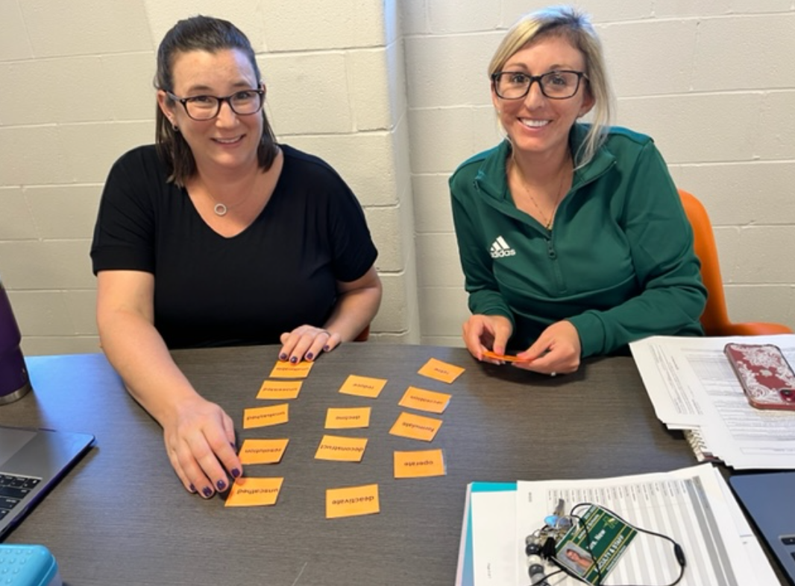
Power of Partnerships
Extended Learning Grants
Training and facilitation in dyslexia supports
Family and Community Partnership Liaison
Strengthening the Education Workforce
Connectivity Champions
From the Educational Service Center of Lorain County: Amherst teachers participating in dyslexia and adolescent literacy

Slide 11
Share Your Story
Featuring “Spotlights” of Promising Practices
Share stories by completing a brief survey

Slide 12
ACE Educational Savings Account Program

Slide 13
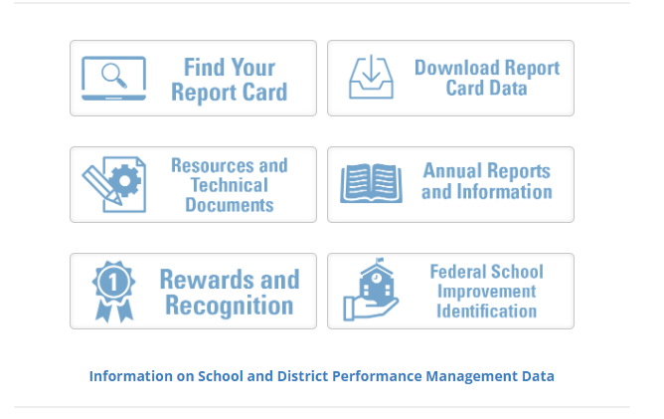
Report Card Resources Website
Detailed information about each report card component calculation
education.ohio.gov/reportcardresources

Slide 14
Report Card Guiding Principles
Ratings should be fair, valid and accurate.
Transparent and encourage high expectations.
Transition time that recognizes impact of pandemic
Emphasize growth and improvement.

Slide 15
2022 Key Takeaways
Report card consistent with Board principles.
Performance results consistent with expectations.
Results further emphasize need to focus on literacy and accelerating learning, including numeracy.

Slide 16
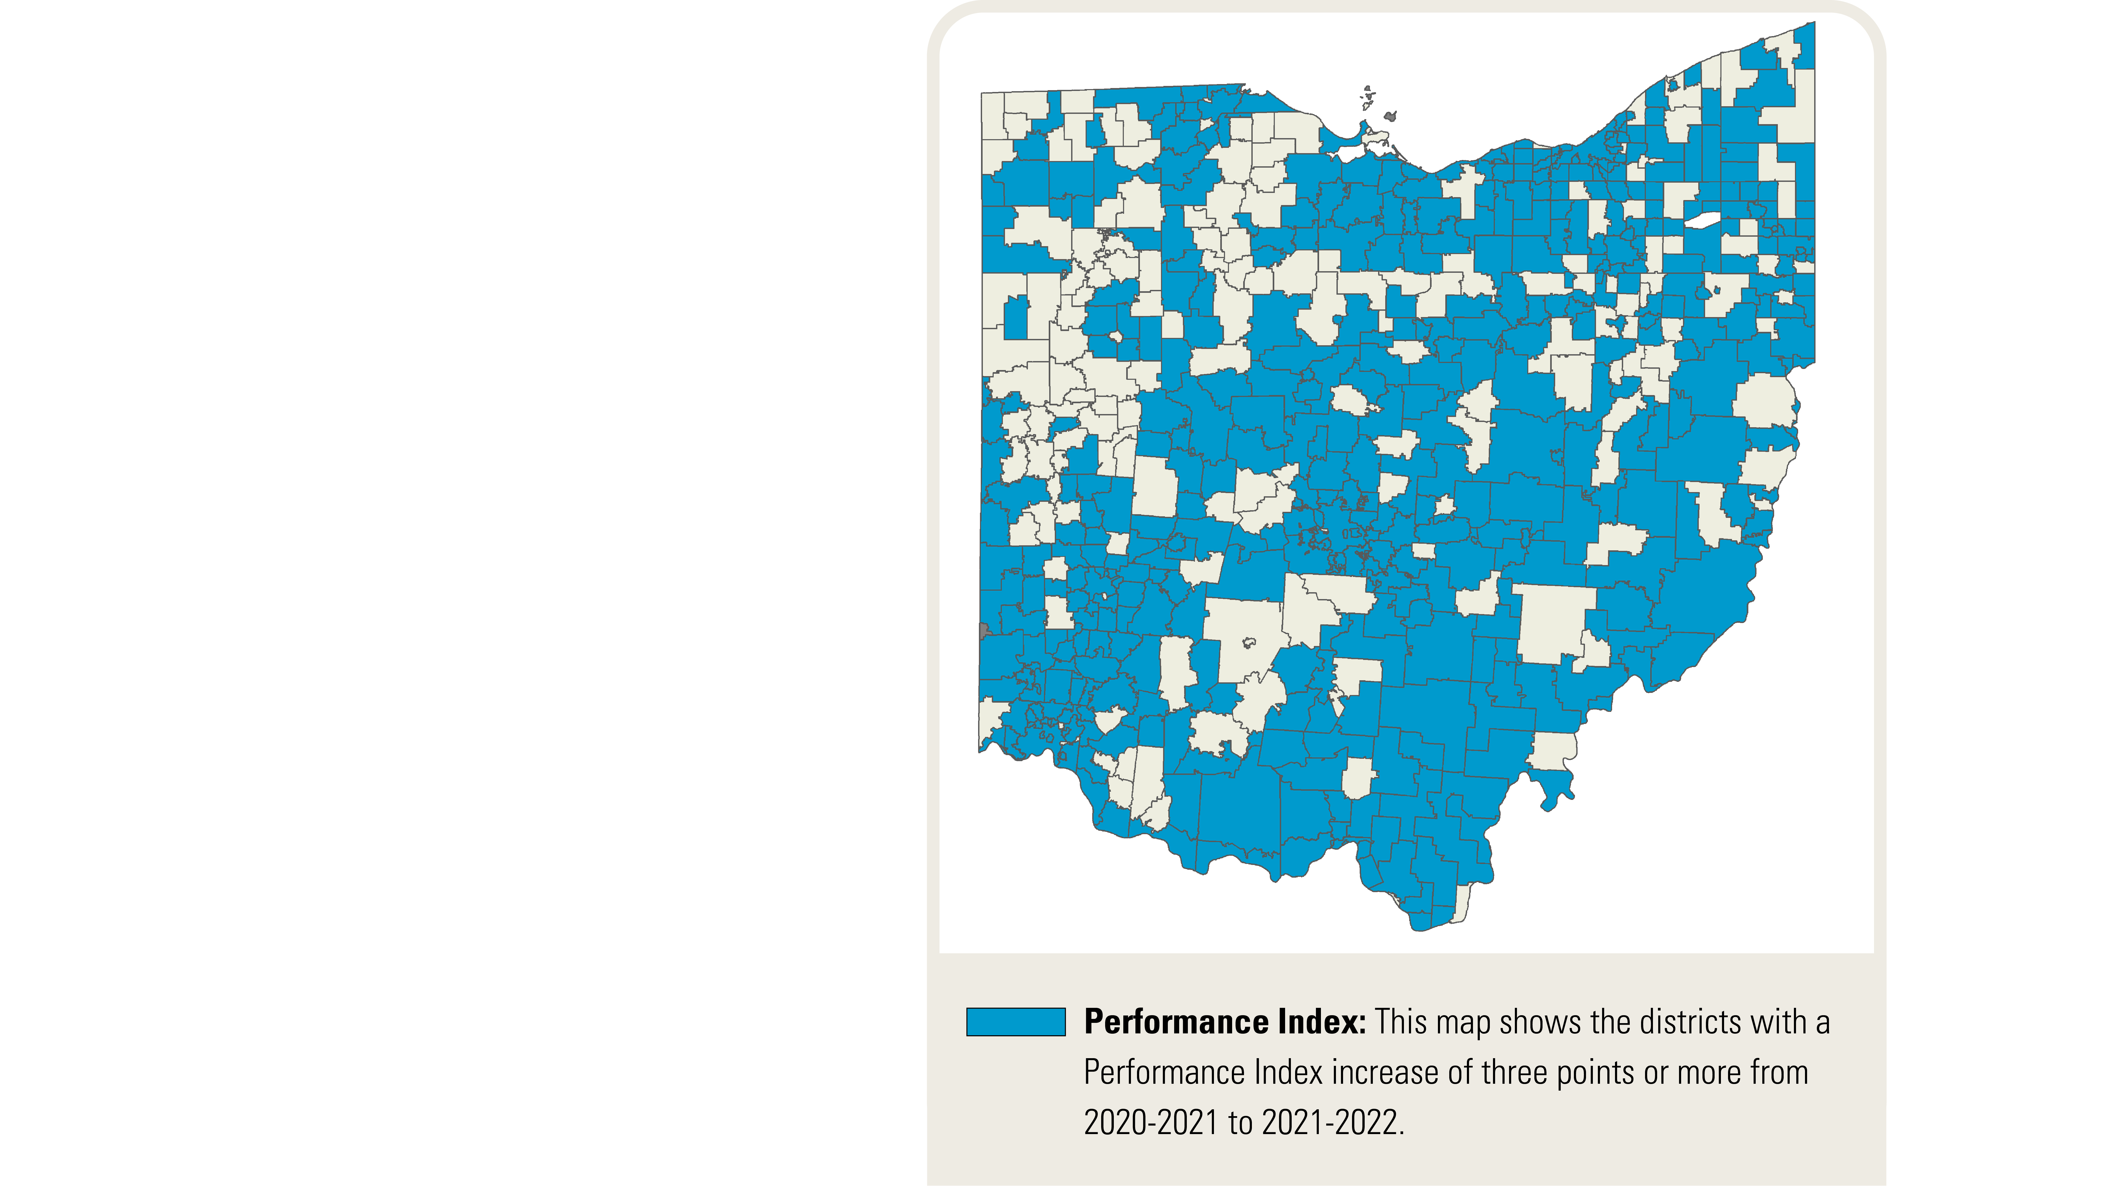
Across the state, 2,312 schools (69.4%) and 438 districts (72.2%) increased their Performance Index by at least three points in the 2021-2022 school year.

Slide 17
Reading proficiency as demonstrated on the reading segment of the third grade Ohio’s State Test for English language arts is included on the report cards for the first time.
60.1%
of third grade students scored proficient or higher on the reading segment of the assessment.

Slide 18
Ready for Every Next Step

Slide 19
@OHEducation

