Slide 1
EduRecoveryHub
May 2nd, 2022

Slide 2
Setting the Stage
We’re here today to:
Show highlights from our EduRecoveryHub platform and what we’re learning
Share Ohio-specific efforts we’re aware of and our interest in learning more
Discuss ways we can work together to provide you with promising practices for your work and engage around longer-term implementation

Slide 3

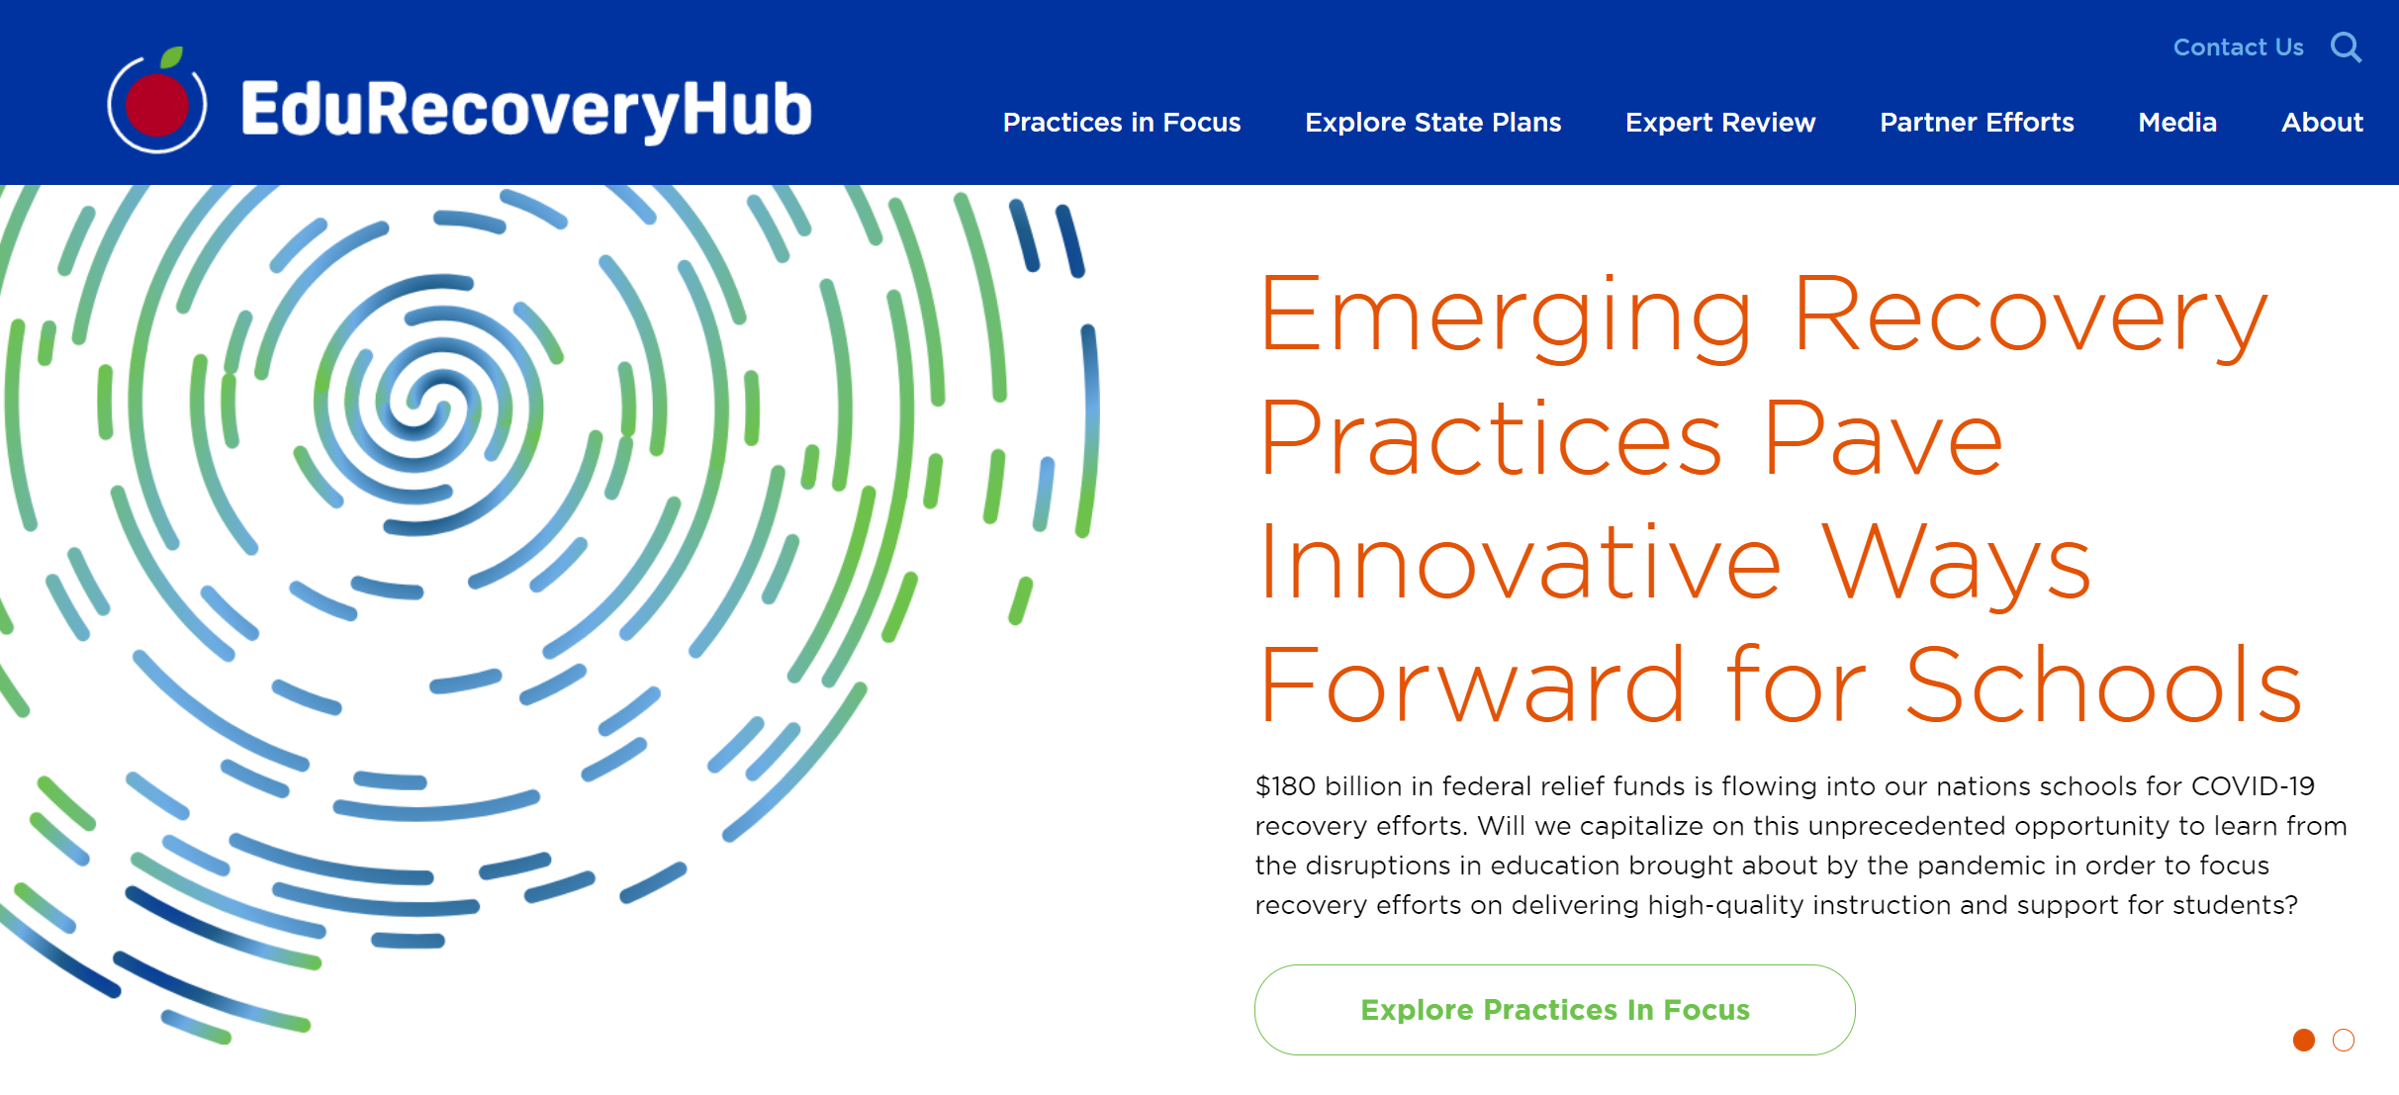

Slide 4

Why Did We Create EduRecoveryHub?
State and district leaders need practical, concrete examples of how to use recovery dollars that are endorsed by experts.
is designed to be a(n):
Advocacy tool to help make the case for smarter investments and for continued targeted funding
Equity check to ensure funds are meeting the needs of underserved students and communities
Research tool to empower the field to monitor and measure what works and the impact on students

Slide 5
Haven’t Schools Already Used These Funds? Isn’t it too late?
We’ve heard these questions from all levels, but the answer is NO!
State and District plans are not etched in stone. They can change.
Federal funds will continue to be spent for the next 3 years.
Leaders can and should make mid-course corrections to improve outcomes.

Slide 6

Who Contributed to this Work
Partners
Panel of Experts
TNTP
Education Trust
National Parents Union
Learning Heroes
The Rural Alliance
Data Quality Campaign
EdAllies
New Leaders for New Schools
Leslie Villegas
John White
Dale Chu
Jocelyn Pickford
* Reviews coming from SREB and Bush Institute

Slide 7
How We Organized the Work
Accelerate learning
Improve facilities
and tech
Use data to drive decisions
Promote family engagement
Support students, families, and staff
Invest in bold new ideas
Strengthen the
educator workforce

Slide 8
What We Found: So Far…
23
10
41
States Spotlighted
District-level
Initiatives
Practices

Slide 9
What We’re Finding: Colorado
Colorado Offering Free Mental Health Services
  Students between ages 12 and 18 can go to the I Matter state website to take a short survey to assess their needs. If the results show they need help, the site will connect them to a provider for a 45-minute appointment within two weeks.
“Thumbs Up” from Learning Heroes, National Parent Union, John White and Leslie Villegas
“Badly needed, scalable, and creative. It makes a lot of sense, and if it works ostensibly it could be done anywhere.”
    - John White

Slide 10

What We’re Finding: Georgia
Atlanta Schools Strengthening Educator Pathways to High-Needs Schools and Subjects
  Atlanta is offering bonuses, stipends, and hiring incentives up to $3,000 for educators to expand learning time and to serve in high-poverty schools and high-needs classrooms.
“Thumbs Up” from Learning Heroes, Rural Alliance, Jocelyn Pickford, and EdAllies
“This investment is laser-focused on equity: ensuring more instructional time for students that need it most, and creatively allocating resources to ensure the best teachers are there to provide it.”
  - Dr. Eyal Bergman, Learning Heroes

Slide 11
What We’re Finding: Texas
Fort Worth, Texas Schools Hiring Over One Hundred Family Engagement Specialists
  $11.7 million in federal funds to hire more than 100 “Family Engagement Specialists” and to provide them with professional development in areas such as attendance monitoring, ensuring a welcoming school environment, social media management, social emotional learning support, etc.
“Thumbs Up” from Learning Heroes, Rural Alliance, EdAllies, Jocelyn Pickford, and DQC.
Critical Feedback that we will share with the district:
  “The outcomes they are seeking are all based on improving attendance goals…nothing to do with parent advocacy, cooperative collaboration with parents and families.” – Keri Rodriguez

Slide 12
What We’re Finding: Connecticut
Connecticut Using Some Funding to Strengthen Evaluation, Research of Education Investments
  The Connecticut State Department of Education is using reserves from its ARP and ESSER funds to establish the COVID-19 Education Research Collaborative (CCERC) to evaluate investments on an ongoing basis to determine efficacy, provide high-quality data, and guide resource decisions for the students most in need.
“Thumbs Up” from EdTrust, Learning Heroes, National Parent Union, EdAllies, DQC, TNTP, Jocelyn Pickford, and John White – **MOST RECOGNIZED PRACTICE**
“There are a lot of investments being made to address pandemic schooling, and we would all benefit from learning what was most effective and what wasn’t.”
  - Dr. Eyal Bergman

Slide 13
Connecticut’s CCERC
A collaboration of researchers from universities across Connecticut that:
  Conducts evaluation studies of COVID-19 related projects funded through the Connecticut State Department of Education.
  Conducts research studies on areas of import as may emerge due to the COVID-19 pandemic.
CSDE sets the agenda, identifies projects, provides funding. Funding flows through UConn.
Steering Committee of 5 partnering universities select research team for each study based on interest.

Slide 14
Connecticut’s CCERC
Current Research Efforts Underway
  2020-21 Summer Enrichment Evaluation:
    The degree to which camps increased students’ access to summer programming;
    How camps used Summer Enrichment funds and the types of programming they offered.
    students’ enjoyment of camp activities and experiences; and
    How the camps readied students to return to school after a year of pandemic-related disruptions.
  Study Design included:
    Staff and student surveys.
    Two months of site visits to 10 of the 25 camps.
    Focus groups of students and staff at each camp.

Slide 15
Connecticut’s CCERC
Current Research Efforts Underway
  Remote Learning Audit/Expected in Fall 2022
    Document the learning formats (e.g. remote, hybrid) that were provided to students.
    Describe the implementation of these learning formats and efforts to support them.
    Analyze student access to key supports such as mental health and nutrition.
    Analyze key outcomes, including student performance, student absenteeism, and student physical and emotional outcomes.
  Learner Engagement and Attendance Program (LEAP)/Expected in Winter 2023
    Describe LEAP’s recipients and providers.
    Analyze its overall impact by sub-groups.
    Examine recipients’ and providers’ experiences
    with this intervention.

Slide 16




STATE DEEP DIVES
Arizona - $21.3 million to fund school counselors and social workers in 140 schools
Tennessee - $200 million in a statewide tutoring program that will reach 150,000 students
North Dakota – 1/3; 1/3; 1/3 Spending Plan
Kentucky – Innovative Use of State Set-Aside

Slide 17



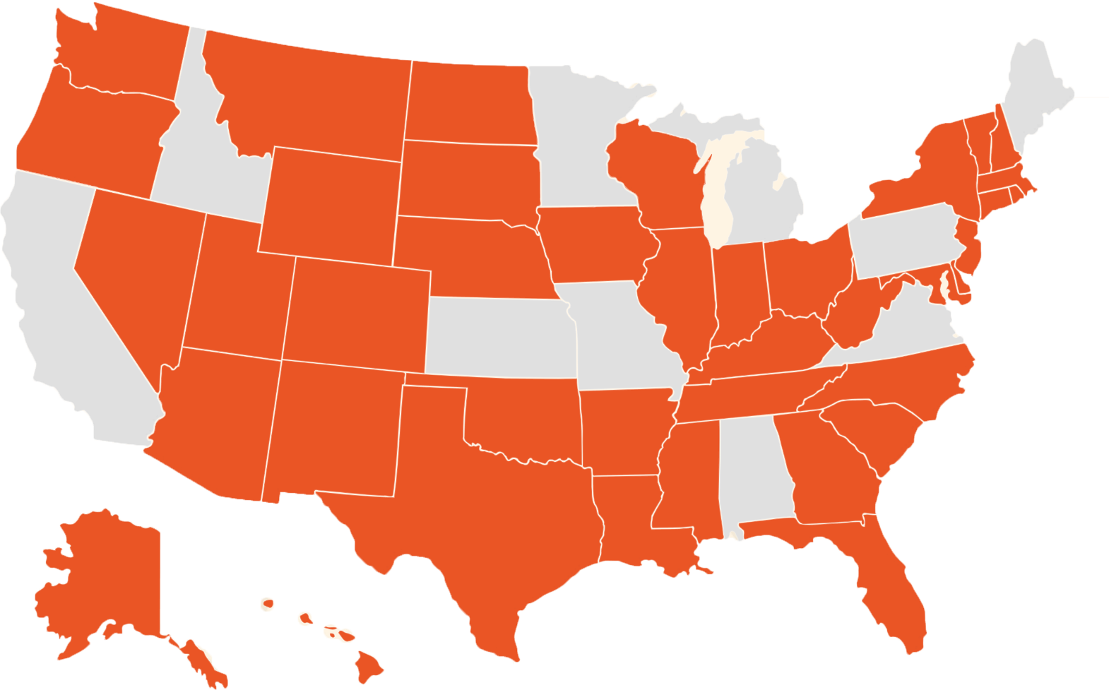

State-Level Curriculum Resources and Guidance
Partner Research + Resources
Original Commentary + News

Slide 18

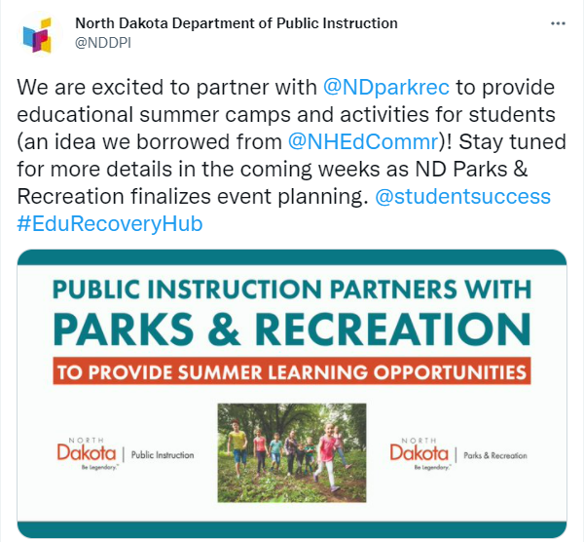

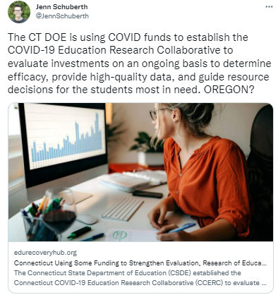
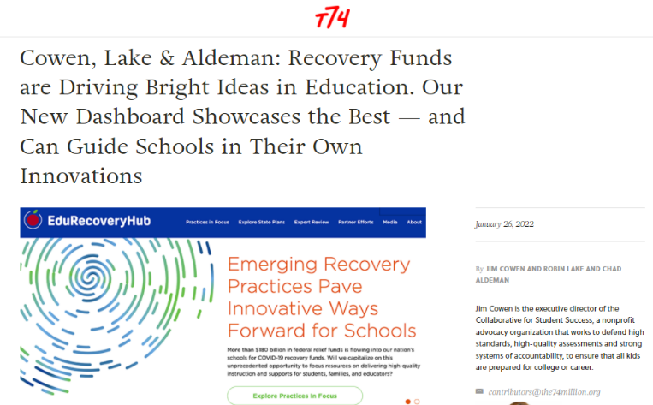

Media

Slide 19

Ohio
One Effort Featured on the Hub So Far: $2.2 million investment from state GEER funding by the Ohio Department of Developmental Disabilities to launch Learning Aid Ohio.
    Virtual, personalized tutoring service program providing support to 1,200 families of students with individualized education plans (IEPs) by connecting them to a virtual tutor and other education professionals.
    Data shows the program has already resulted in a dramatic increase in perceived level of student educational success.
    “Thumbs Up” from New Leaders, Leslie Villegas, Rural Alliance, and DQC.
We want more examples of great work happening across the state.
  Responses to state guidance on using ESSER funds to support STEM education (summer learning, after-school, high quality PD, curriculum supports, school-wide approaches).

Slide 20
The reality is that we’ve never done this before…
How can we ensure the successful implementation of these promising investments? We want to hear more from you!
State procurement and grant policies may lead to difficulties in meeting the 2024 deadline.
Leaders are struggling to increase human capital and capacity for key functions like research & technical assistance.
There is little time or space to slow down and plan strategically.

Slide 21
What is Next!
Recovery Hub work continues, potential next steps with partners and additional workstreams to consider/already underway.
State & District Leader Convening on Sustainability
  NPU/Epic Campaign: Top Ten Investments Advocacy Tool
  More Practices Coming
  Additional Deep Dives and Implementation Follow-Up
CONTACT:
Adam E zr A
Ezring@forstudentsuccess.org

Slide 22



Contact Us
Jocelyn Pickford
jocelyn_pickford@hcmstrategists.com
Dr. Christine M. T. Pitts
cpitts8@asu.edu
Adam Ezring
aezring@forstudentsuccess.org

