Slide 1
Amplifying Your Impact: Mastering Effective State Advocacy
November 29, 2023
2:00 p.m.
Grand Ballroom E
Notes:
I. Introduction (3 minutes)
A. Welcome and opening remarks
B. Briefly introduce the importance of state-level advocacy
C. Provide an overview of the presentation’s structure

Slide 2
Welcome
“Politics is not an end, but a means. It is not a product, but a process. It is the art of government. Like other values it has its counterfeits. So much emphasis has been placed upon the false that the significance of the true has been obscured and politics has come to convey the meaning of crafty and cunning selfishness, instead of candid and sincere service.” -- Calvin Coolidge, 30th President of the United States
“It has been said that politics is the second oldest profession. I have learned that it bears a striking resemblance to the first.” ― Ronald Reagan, 40th President of the United States

Slide 3
Pre-Session Polling

Slide 4
Overview
This presentation will delve into the art of effective state advocacy, emphasizing the pivotal role of state-level engagement with legislatures, state agencies, and rulemaking authorities.
Notes:
Advocacy at the state level can yield substantial policy changes and is often a catalyst for broader national shifts. It is why you will see AESA taking a more direct interest in supporting state level advocacy efforts.
This session will equip you all as attendees with essential strategies and insights to navigate the complexities of state-level advocacy, helping you make a meaningful impact on the issues you and your ESAs are passionate about. Whether you are an educator, administrator, advocate, lobbyist, or concerned citizen, I hope that you leave with ideas and the beginning of a toolkit to drive change at the state level and beyond.

Slide 5
Learning Objectives & Outcomes
Establish a common definition of advocacy.
Understand the importance of state-level advocacy and lobbying.
Comprehend the key components and branches of state government and how to effectively influence them.
Review potential tools to support advocacy campaigns.
Reflect on key takeaways and address participant questions.

Slide 6
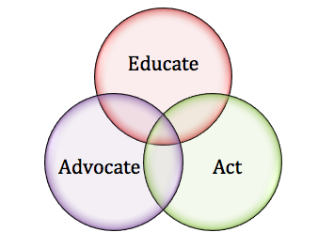
Defining Advocacy
Advocacy means persuading people who matter to care about your issue.
It’s a right enshrined in our Constitution:
“Congress shall make no law respecting an establishment of religion, or prohibiting the free exercise thereof; or abridging the freedom of speech, or of the press; or the right of the people peaceably to assemble, and to petition the Government for a redress of grievances.”
Notes:
Building knowledge, understanding and capacity. Equipping yourself and your champions with the strategies and tactics to advance priorities. Compelling policy makers to act in support of your interests.

Slide 7
The Idea-Advocacy Matrix
 |  | Quality of Idea
 |  | Poor | Good
Advocacy for Idea | Ineffective | (1) Lucky Break | (3) Lost Opportunity
 | Effective | (2) Wasted Investment | (4) SUCCESS!
Source: “Advocacy”, John A. Daly, 2011
Notes:
Our goal is effective advocacy for good ideas! We want to avoid lost opportunity – which is ineffective advocacy of a good idea - at all costs.

Slide 8
Why Advocate/Lobby?
Reasons for advocacy and direct lobbying are many and varied:
To gain better laws
To protect favorable laws
To repeal unfavorable laws
To stop unfavorable proposals (bills) from becoming law.
To impact state executive agency decision making

Slide 9
Primary Focus Areas of Government
Local Government
Police, water, sewer, trash, power, parking, cable, etc.
State Government
Education, voting and elections, state taxes, driver licenses, professional licenses, etc.
Federal Government
Defense, interstate commerce, monetary regulation, healthcare and retirement, federal taxes, etc.
Notes:
For the purposes of this presentation, we will focus on state-level advocacy
Professionally, most educators, because it is a responsibility left primarily to the states, will experience more day-to-day impact from state policy and funding decisions.
In our daily, personal lives we are likely more directly impact by local government.

Slide 10
State Government Roles
Educate
Medicate
Incarcerate
All supported through the appropriations process
Notes:
For most states, primary cost drivers are Medicaid, Primary and Secondary Education and Rehabilitation & Corrections. These are all supported through the state budget process referred to by one former State of Ohio Budget Director as the “allocation of disappointment.”

Slide 11
Who Do We Target with Advocacy/Lobbying?
Office of the Governor
Executive Agencies
Legislators
Staff
Special Interest Groups
Media
The Public
Notes:
Office of the Governor – (ability to use the “bully pulpit”)
Executive Agencies – (before, during and after – charged with implementation of laws)
Legislators – (key decision makers)
Legislative Staff – (as important, if not more so, than legislators – “Gatekeepers”)
Special Interest Groups (keep your friends close and your enemies closer)
Media – (capturing the power of the airwaves and print)
The Public – (can help to build critical mass)

Slide 12
Things You Can Ask a Lawmaker to Do to Help Advance Your Issue(s)
Introduce legislation;
Cosponsor legislation that has already been introduced;
Vote for a specific piece of legislation;
Vote against a specific piece of legislation;
Introduce, support, or oppose an amendment to a specific piece of legislation;
Make a speech on the floor of the House or Senate;

Slide 13
More Things You Can Ask a Lawmaker to Do …
Talk to another legislator who share the same geography, party, committee assignment, or voting demographics;
Talk to local news media about the issues or bills you care about;
Visit your ESA or affiliated groups and organizations to get a deeper understanding of your issues and to demonstrate support for your issues;
Circulate or sign a “Dear Colleague” letter – not legislation but a letter expressing support for a particular piece of legislation.

Slide 14
Things That Influence Lawmakers
Getting Elected
Political Parties
Campaign Contributions
Other Lawmakers
Getting the Majority
Social Media
Scholars and Researchers
Their Own Life Experiences
Keeping the Majority
Legislative Staff
Institutional Support (Legislative Service Agency, Auditors, etc)
Getting Re-Elected
Community-based Advocates (Constituents)
Statistics from the District
Real-life Examples
Issue Expertise
Access to district voters
Local News Media Opportunities
News Media

Slide 15
Relationship Building
Regular communication, attending town halls, fundraisers, and other events, can help you build rapport and trust.
Sharing stories, experiences, and data relevant to your cause can make legislators more receptive to your message.
The most important time to meet with lawmakers and establish relationships is when you don’t need anything.
Notes:
Establishing personal connections with legislators and their staff can significantly impact your lobbying efforts.
Importance of Relational Relationships vs. Transactional Relationships.
Transactional means expecting something in return for ESC contributions whereas relational means will to be patient for a longer-term mutual benefit.
This can be difficult in political environment, initiative driven environments or under fiscal constraints.
Transactional relationships can breed resentment
Our politicians still don’t always understand this
Can also breed resentment when some of the network is not included.

Slide 16
Developing an Advocacy Plan
Biennial or Annual Activity
Includes:
Priorities
Position statements
Goals
Strategies
Consider the environment and ability to achieve success

Slide 17
Distinguishing Between Strategy & Tactics
An advocacy strategy is the roadmap that provides direction and purpose to the advocacy effort.
Tactics are the day-to-day activities aimed a executing the strategy and achieving short-term objectives and may change based on the evolving circumstances of the campaign.
Source: “Advocacy”, John A. Daly, 2011
Notes:
An advocacy strategy is the overarching plan that guides the entire campaign. It involves setting long-term goals, identifying target audiences, and outlining the overall approach to achieving the desired change. Think of it as the roadmap that provides direction and purpose to the advocacy effort.
Tactics, on the other hand, are the specific actions employed within the broader strategy. These are the day-to-day activities aimed at executing the strategy and achieving short-term objectives. Tactics are adaptable and may change based on the evolving circumstances of the campaign.

Slide 18
Context Matters
Context – the current culture in a state – will have a direct impact on the outcome of your issue.
Understanding current context, political composition, etc., can help you to navigate political waters and accomplish the desired outcomes.
Notes:
“Culture trumps strategy every time.”

Slide 19
Context Matters: Ohio Trends
Slow Growth Economy
Plateau in Manufacturing & Agricultural Activity
Transition to Service Sector and Knowledge Economy
Growth in Healthcare and Public Sector
Slow Population Growth
Aging Population
Increased Reliance on Federal Government
Expansion of School Choice
Low Educational Attainment
Notes:
Result? A constraint on Ohio’s revenue base and an expanded demand for public services.

Slide 20
Key Steps in OESCA’S Advocacy Work
Research
Set Priorities
Identify Issue Areas
Monitor
Develop Decision Making Criteria
Advocacy
Direct Lobbying

Slide 21
Idea Assessment
 | Current State | Proposed Policy Idea | Compromise Idea 1 | Compromise Idea 2
What problem is the idea trying to solve?
What are its relative advantages?
What makes it distinctive?
What other policies or programs is it comparable with?
How complex is it?
What is its history
Should it be in permanent law, temporary law or agency rule?
Source: “Advocacy”, John A. Daly, 2011

Slide 22
Research & Data
Demonstrating the potential benefits of your proposal and its alignment with the legislators’ constituents’ needs can be persuasive.
Reliable information can counter opposing arguments and make your case more compelling.
Self-reported data, particularly at the programmatic level, can be compelling;
Whenever possible use publicly available state-level data for comparative purposes to demonstrate overall impact or need.
Notes:
Providing well-researched data, facts, and statistics that support your cause enhances your credibility and strengthens your argument.

Slide 23
Enhancing Formal Arguments with Personal Stories
 | Formal Argument | Personal Story
Argument v. Personal Story Issue: Shared Services Through Educational Service Agencies Parent: Family of Preschooler with Autism | The ABC ESA provides cost-effective, quality preschool services to students with disabilities by sharing costs across multiple smaller districts that might not otherwise be able to provide services on their own. Last year, the ESA provided preschool services at a cost of 15% less than the client districts providing it themselves our outsourcing to a third-party, private provider. | At 2 years old, Jane was nonresponsive to us saying her name, did not show any signs of verbal communication, and had little interest in any of the toys put in front of her. She was ultimately diagnosed with autism. As parents, we were unclear of how to navigate the system and concerned about what this meant for her future. Because of the early intervention services through the ESA’s “Achieve” program, Jane will be attending kindergarten this year without the assistance of a full-time aide and we feel positive about her future.
Source: “Advocacy”, John A. Daly, 2011

Slide 24
Coalition Building
Forming alliances with like-minded organizations, interest groups, and constituents can amplify your lobbying efforts.
Collaborating with diverse partners can also help you cover different angles and expertise, making your advocacy more comprehensive.
The most effective education-focused coalitions often include cross-sector representation from external partners outside of one’s area of interest including members of the business community.
Notes:
A united front can present a broader and more influential voice, showcasing widespread support for your cause.

Slide 25
Strategic Communication
Presenting solutions that address specific concerns can make your proposal more appealing.
Utilizing various communication channels, such as emails, phone calls, social media, and in-person meetings, can maximize your impact.
Developing talking points inside of a broader advocacy campaign and sharing those with those within your organization or coalition can help support a clear, consistent and unified voice.
Stay on Message!
Notes:
Crafting clear and concise messages is crucial. Tailor your message to resonate with legislators’ priorities and the interests of their constituents.

Slide 26
Grassroots Engagement
Grassroots engagement grows out of one’s organization and coalition building and should be supported through consistent and strategic communications within an overall advocacy campaign.
Legislators often value the opinions of their constituents, and a groundswell of local voices can influence their decisions.
Encouraging citizens to write letters, make phone calls, or attend meetings can demonstrate widespread public support for your cause.
Notes:
Mobilizing constituents to engage with legislators can be a powerful lobbying strategy.

Slide 27
Advocacy Tactics
Have a Plan and Theory of action
Politics
Policy
Planning
Partners
Process
Profile
Notes:
OESCA and its membership will implement a comprehensive government relations lobbying strategy focused on the Ohio Statehouse that includes:
Monitoring legislation introductions and committee hearings;
Attending relevant House and Senate Committee hearings;
Drafting legislation and amendments;
Preparing and providing House and Senate testimony;
Coordinating and participating in Ohio House and Senate member briefings;
Coordinating and participating in executive branch decision maker briefings; and
Coordinating regional “in district” briefings with targeted Ohio House and Senate members.

Slide 28
Advocacy Tactics (Cont.)
Constituents & Key Contacts
Public Testimony
Letters/Emails
Phone Calls
Media
Coalition Building
Social Media
Briefings
Legislative Breakfasts

Slide 29
Advocacy Tactics (Cont.)
Other Ideas
Legislative Breakfast
Community Forums
Program Visits
Social Media Strategy
Student-led or –created content (videos, publications, etc.)

Slide 30
Advocacy Tools OESCA ADVOCACY PAGE
Federal and State Policy Forecasting Tool
Bill Monitoring Tool (Example)
Stakeholder Tracking Report
Opposition Research Report
Advocacy Decision Framework
State Initiatives Decision Framework
Elevator Speech Activity and Samples

Slide 31
The “Knowledge-Feeling” Matrix
LEGISLATORS
Naïve Followers
Cheerleaders
Cynics
Adversaries
Educate, Involve, Ground Commitment
Amplify, Activate, Support
Abandon, Convert
Persuade with Evidence, Minimize Opposition
Positive
Feelings About Idea
Negative
Low
High
Knowledge About Idea
Source: “Advocacy”, John A. Daly, 2011
Notes:
Generally, people are either for your idea, against your idea or have no opinion. And, legislators generally fall somewhere in the middle across all of those categories.
This is modified from a matrix in the book “Advocacy” By John A. Daly. Ideally, you want to convert your cynics. But, at a minimum silence their concerns. For your Followers, you need to continue to educate and involve and make them cheerleaders. Your cheerleaders – you client districts, parents of students that have benefitted from services, your board members and staff – these are your active advocates; they need to amplified and supported to actively engage with policy makers. And, lastly, your adversaries. You may never get them on board. BUT you must MINIMIZE the opposition.

Slide 32
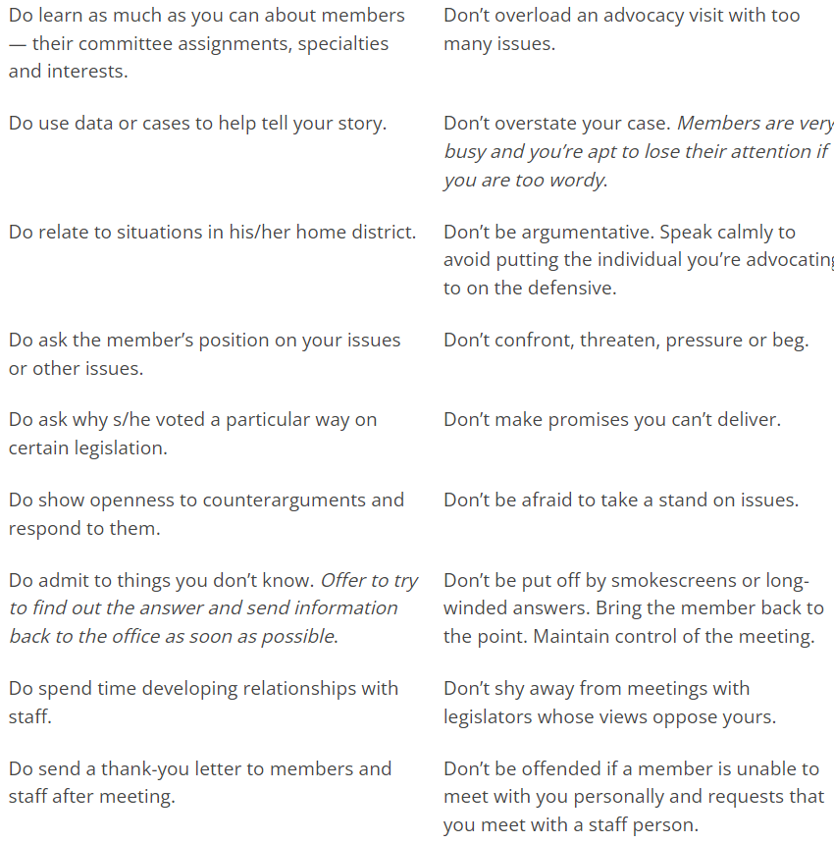
Advocacy Do’s & Don’ts
Do your homework.
Build relationships when you don’t need them
Have a narrow focus.
Use stories.
Appeal to their self-interest.
Stay on message.
Follow up
Be persistent

Slide 33
Resources
Government
National Center for Education Statistics
https://nces.ed.gov/
State Policy Organizations
Education Commission of the States
https://www.ecs.org/
National Conference of State Legislatures
https://www.ncsl.org/education
National Governors Association
https://www.nga.org/
Think Tanks
Pew Center
https://www.pewresearch.org/topic/other-topics/education/
Associations
AESA: AESA State Examiner
https://www.aesa.us/state-examiner/

Slide 34
Discussion Questions
How can you engage your staff and community in effective advocacy for your organization?
How often do you or should you engage with legislators or legislative staff?
What information do you collect and share with elected representatives? When?
What are the most effective ways to build trusting, sustained relationships with elected officials?

Slide 35
Craig Burford
Craig Burford has served as the Executive Director of the Ohio Educational Service Center Association (OESCA) since August 2000. Prior to joining OESCA, Craig was the Director of Communications and Government Relations for the Ohio SchoolNet Commission from 1999 to 2000. From 1996 to 1999, He served as legislative aide and chief of staff to State Senator Pro Tempore Bob Cupp (R-Lima). Craig began his work in state government and policy analysis as a Legislative Service Commission Intern in 1995 after graduating Bowling Green State University with a B.A. in History and Political Science.
burford@oesca.org
614-561-6818

