Slide 1
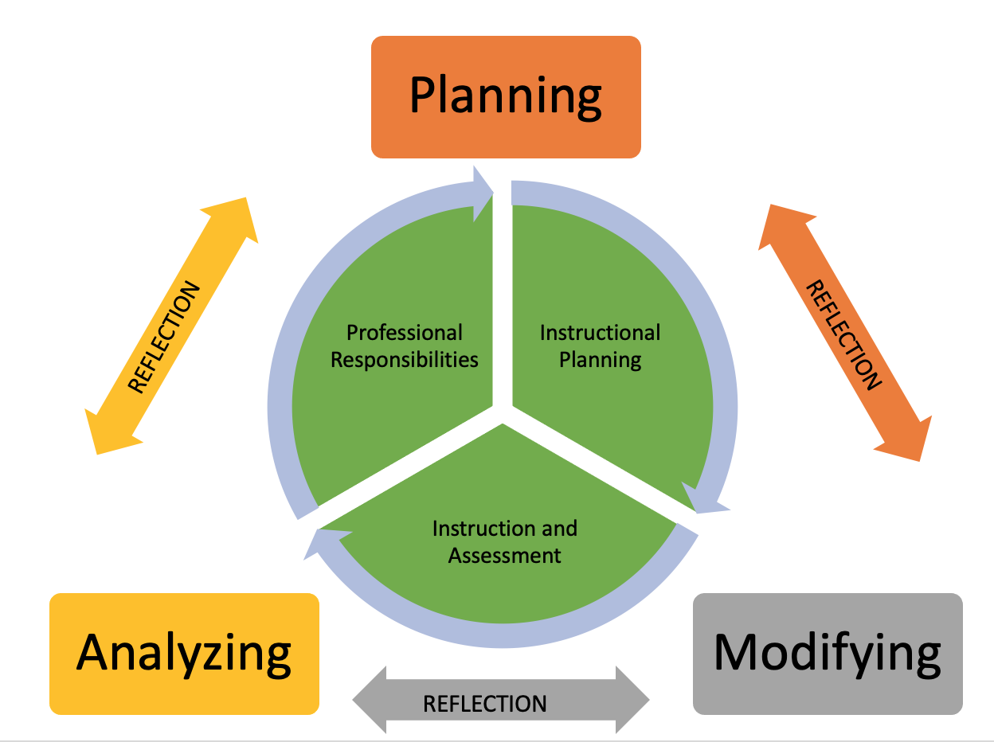
Data Coaching:
Using Data to Analyze, Plan, and Modify Instruction
Resource Document:
bit.ly/datacoaching22
Notes:
(5 minutes)
Welcome. Introductions, housekeeping.
Thank you for choosing to spend some time with us today. There is a document with links to the slides and the resources for the module. The link will be placed in the chat and the bit.ly link is on this first slide.
Resource Document
https://docs.google.com/document/d/1Vt4OVSGvIupivqi42FST0Ev7pNF364vHVhtIXsIce3Q/copy
bit.ly/datacoaching22
Link to published version of the slidedeck
https://docs.google.com/presentation/d/e/2PACX-1vROipQcivOgVPf1DOVh7CzoCOW9L0McA4hFfBE7dPzp5NWr1nkzOXJ6NmGRxNWPLNKbtKneBR3A3heD/pub?start=false&loop=false&delayms=3000

Slide 2
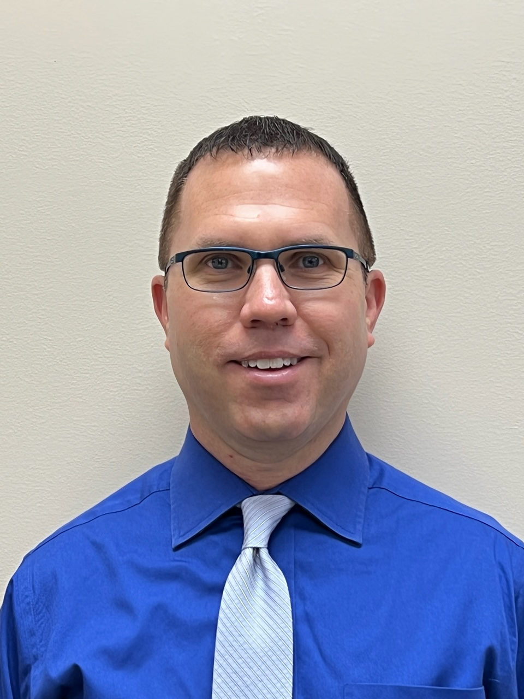
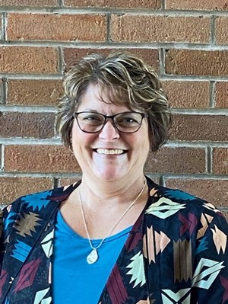
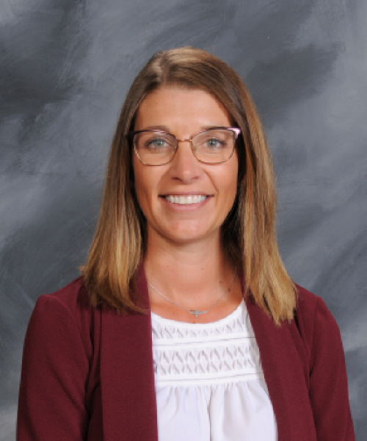
The Regional Data Lead (RDL) Design Team:
Data Coaching
Dr. Bryan Drost
Rocky River City
North Central Ohio ESC
Dr. Kristi Graves
North Central Ohio ESC
Mindy Geschke
ESC of Northeast Ohio
Dr. Kathy Harper
Greene County ESC
Gary Herman
Putnam County ESC
Susan Larson
State Support Team Region 12
Michael Ross
Hamilton County ESC
Lindsey Schmiesing
Mercer County ESC
Cherie Smith
State Support Team 6
Stephanie Wagoner
Brown County ESC
Notes:
(1-2 minutes)
The Design Team collaboratively supported the content development for the Data Coaching module and developed resources to support conversations around using data to reflect, analyze, plan, and modify. This presentation is designed to support RDLs in their work with area districts. It provides a platform of slides and resources to use when delivering regional and/or district level presentations.

Slide 3
Today’s Learning Targets
Big Idea
Use the analyze-plan-modify cycle to coach teachers in their usage of data to improve instructional practice and student learning.
Analyzing | Planning | Modifying
I can analyze patterns and data sources to coach teachers. | I can use trends and patterns within data sources to coach teachers to plan appropriate instruction for students. | I can coach teachers to modify instruction to meet student needs based on the ongoing collection and analysis of data.
Reflection
Notes:
(3-5 minutes)
(Review the training learning targets by asking participants to take a minute to read them.)
The overarching goal or ultimate goal that we have for our learners is to provide support to educational leaders in promoting educator professional growth that leads to improved instructional performance and student learning through data analytics.
We ask that you fully participate in today’s learning activities in order to simulate the best coaching environment you can take back to teachers in your schools.
We will be using the OTES 2.0 rubric as our anchor. Here are our “I can” statements for learning:
Data Coaching: I can use the analyze-plan-modify cycle to support teachers in their usage of data to improve instructional practice and student learning.
Analyzing: I can analyze patterns and data sources to coach teaches.
Planning: I can use trends and patterns within data sources to coach teachers to plan appropriate instruction for students.
Modifying: I can coach teachers to modify instruction to meet student needs based on the ongoing collection and analysis of data.
All of these slides and materials will be made available to you, so that you can utilize these resources in training situations with districts (in full or part). You will find some slides are hidden throughout so you can modify and add extension activities that best fit the needs of your audience. Again, the training may be abbreviated or extended as needed or as time permits.

Slide 4
Overview of the Data Coaching Cycle
Notes:
(2-3 minutes)
The graphic illustrates the cycle of data coaching showing that it is a recursive process. For training purposes, we are examining and breaking the process into components which include analyzing, planning, and modifying.
One may think that we would start with planning in mind during this process. And yes, planning is where one would typically begin. However, in the process of coaching we are going to begin by analyzing and reflecting. Reflection is important throughout the entire process of data coaching. For our training purposes we are going to ask that we keep this recursive (back and forth, using loops to define a problem) process in mind. We must begin by analyzing our data and reflecting upon the data’s meaning before we can plan our next steps. In our next few slides, let’s start by thinking about some data sources.

Slide 5
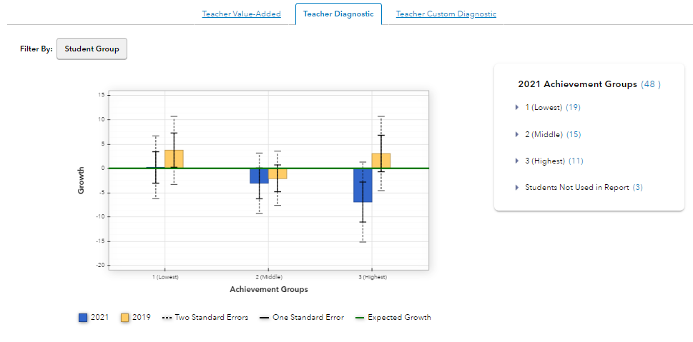
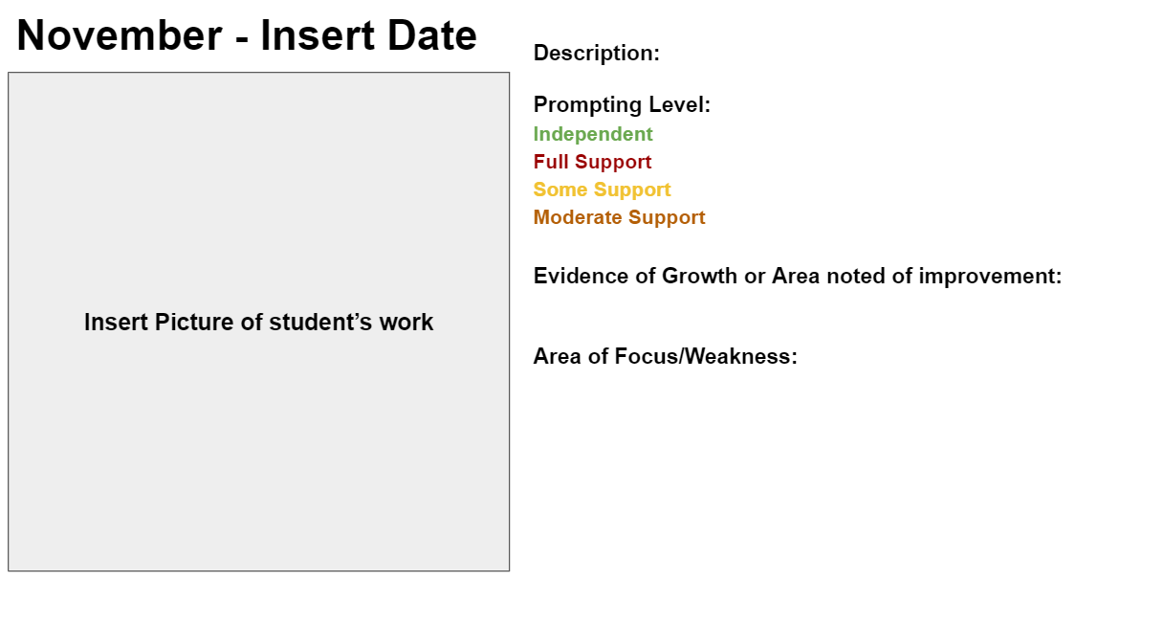
Examples of Data
Readiness Assessments
Value-Added Reports
Portfolios
Notes:
(3 minutes)
Now, let’s turn our attention to various types of data that teachers might be using throughout the school year. Here are some examples of data that can be used throughout a coaching cycle. It is important to remember teachers have many different data sources in addition to the ones displayed.
(Ask participants to share out a few sources of data they might think about using in a coaching cycle. Either unmute or put in the chat (depends on group size).)
This is a warm-up for the next slide and activity.

Slide 6
Sorting Types of Data
OTES 2.0 requires at least two sources of HQSD data but also encourages and requires you to use data in other places within the rubric.
Using this jamboard and the OTES 2.0 rubric, sort the data sources to their appropriate location on the Rubric. Be careful, some can go in more than one place.
Jamboard OTES 2.0 Rubric
Notes:
(Read the slide as is. Remind participants that the links are also on the Resource Document.)
(If you are running this presentation virtually, each participant clicks on the jamboard. If you are running face-to-face, you as the presenter should click on the jamboard link and then SHARE this link on the slide for participants to access.)
This slide has participants think about different types of data and uses the rubric to help begin to think about these in relationship to the coaching cycle.
Participants click on the Jamboard link to create a copy and sort their data.
If you wish participants to work on one Jamboard, you can create a copy yourself as the facilitator, and share that link.
Make a copy of the Jamboard - change the link you made a copy of to anyone with the link can edit - place the new link in the chat bar, if you would like them to collaborate together on the same Jamboard.
Jamboard ways to use with participants:
Only fifty can access at a time - may need each participant/group to make a copy.
Virtually - Make a copy of the Jamboard - on the copy Jamboard change the settings to anyone with the link can EDIT- place the link to the COPY Jamboard in the slide to connect it - create breakout rooms - breakout room number corresponds to jamboard number. (Designate one person from the group to be the recorder)
In Person - Make a copy of the Jamboard - on the copy Jamboard change the settings to anyone with the link can EDIT - place the link to the COPY Jamboard in the slide to connect it- have groups work on their assigned Jamboard page number for discussion. (Designate one person from the group to be the recorder)
Whole Group - Make a copy of the Jamboard - on the copy Jamboard change the settings to anyone with the link can EDIT - place the link to the COPY Jamboard in the slide to connect it - share out as whole group to have conversation (would only need to use first slide)
Steps to change link for participants to see all - https://watch.screencastify.com/v/iuwlP30nFtBoNf3wkeXj
How to create a sticky note - https://watch.screencastify.com/v/MNc1JoXhQusJ67uCM6YT
How to use Jamboard - https://watch.screencastify.com/v/tf9SQhsswdrm97W3PZzJ
Data can go into multiple locations.

Slide 7
The terms used in “Evidence of Student Learning” component on the rubric are not percentages. This was intentional.
Defining critical phrases and terms in these indicators should prompt discussion between teachers and evaluators about what progress looks like…
For students
For specific groups of students
Providing flexibility
Using “colors” as an indicator would not promote this valuable discussion
Data Coaching Conversation Clarification
Notes:
Before we examine data sources for our coaching conversations, there is an important point of clarification we need to make for this data coaching, especially when using the OTES 2.0 rubric as our anchor. Using the OTES 2.0 rubric, let’s turn our attention to this component of the rubric.
The terms used in “Evidence of Student Learning” component on the rubric are not percentages. This was intentional.
Defining critical phrases and terms in these indicators should prompt discussion between teachers and evaluators about what progress looks like…
For students
For specific groups of students
Providing flexibility
Using “colors” as an indicator would not promote this valuable discussion
So, when thinking about data coaching, it will be important to steer the conversation/ discussion to reflect upon what progress for students looks like. Ideally, this would be done at the beginning of the school year as the evaluator and the teacher examine/ analyze the available data and then this coaching conversation will be used to help the teacher plan and modify instruction throughout the school year to best meet student needs.
Best practice will see that the teacher and evaluator are working together proactively using the data coaching model to support students throughout the school year and not using this component of the rubric as a calculation tool.

Slide 8
Analyzing:
I can analyze patterns and data sources to coach teachers.
Notes:
Our learning target for this section is focusing on analyzing patterns and data sources that will support coaching conversations with teachers.
Think about your current practice: How have you had coaching conversations with teachers to analyze data sources in the past?
Remember, we have to start by analyzing the data we have available before we plan our instruction.

Slide 9
Analyzing in the Data Coaching Cycle
Notes:
In the process of coaching we are going to begin by analyzing, which includes reflecting. We must begin by analyzing our data and reflecting upon the data’s meaning before we can plan our next steps. In our next few slides, let’s start by thinking about some data sources.

Slide 10
Brainstorming
Think about this question:
Knowing the data sources you’ve sorted and the examples we have provided, what questions might you ask in order to analyze the data?
Notes:
If running this PD electronically, complete this as a cascading chat (also known as a waterfall chat: https://creativesandbox.solutions/how-to-spruce-up-your-zoom-chat-game/).
We are going to be doing a cascading chat, which simply means you are going to answer the question in the chat, but won’t hit enter until I say “go”. When I say “go” you will then hit enter and we will review the responses.
Think about this question: Knowing the data sources you’ve sorted and the examples we have provided, what questions might you ask in order to analyze the data?

Slide 11
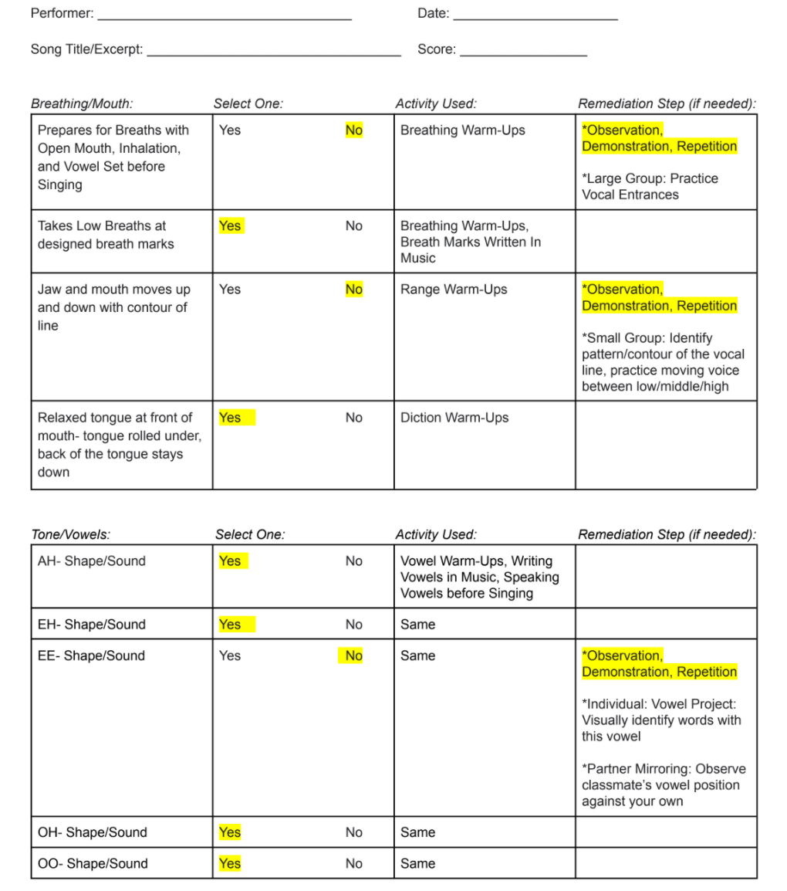
Data Sample Idea?
Accomplished Singer Checklist - Junior High Choir
Notes:
Here is an accomplished singer checklist that a JH Choir teacher is using to gather data. We will be watching a short video (5:13 mins.) that highlights a conversation focused on analyzing the data she has collected. Observe the questions that are being asked to support prompting and helping the teacher explain her analysis.
After watching the video:
What were some key questions that were asked?
What did you observe in the teacher’s response that would align to analyzing data in the OTES 2.0 rubric?

Slide 12
Data Coaching NoteTaker
Data Coaching Notetaker
 | Note Taker
What do you notice in the data?
What patterns or trends are evidenced?
Potential Contributing Factors:
What is missing or lacking? Are there other data you would like to see/review?
Do you see something unusual or surprising that you would like to explore further?
Notes:
(Remind participants that the link is also on the Resource Document.)
Introduce participants to the idea that all of the questions that you mentioned are great questions. The ones that are on the screen are questions that have been shown by research as questions that encourage people to actually make sense of data in an educational setting. (see DataWise). This is a template that you can use a coaching tool when you are having coaching conversations with teachers. Tell participants that they will be using the notetaker as we analyze a set of data for a teacher Mrs. Jackson is a fictional fourth grade teacher. With that being said, you will use your resource sheet to access this note taker - you will be forced to make a copy.

Slide 13
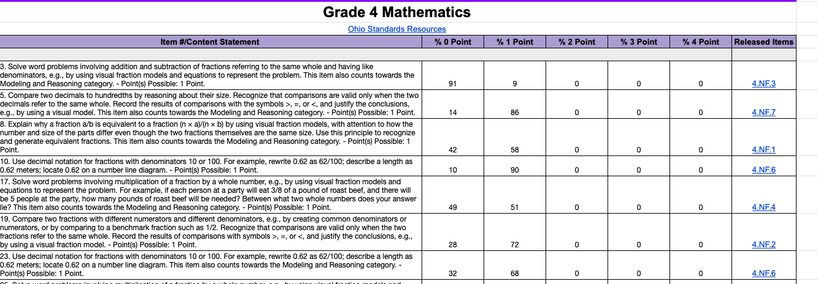
Mrs. Jackson’s Ohio State Test Data Analysis
Mrs. Jackson received grade 4 item analysis data from the Ohio State Test. Take a minute and review the data. We will model this with our notetaker.
Notes:
Read the slide as is. Give participants time to review the data (by clicking on the image, you can access Mrs. Jackson’s data).
Highlights of the data represent the following. Do a talk-aloud. Add this information to the notetaker. Results are on the next slide.
DOK 2 not as well
Modeling and reasoning
Not stretching kids- developing conceptual understanding of content
Stretch question: is this HQSD? Street data?

Slide 14
Data Coaching NoteTaker
Access Document
 | Note Taker
What do you notice in the data? | There are a number of items that large amounts of students are missing (#3).
What patterns or trends are evidenced? | Word problems seem to be challenging for students.
Potential Contributing Factors: | Is the teacher working through conceptual understanding based on the fact that modeling and reasoning questions are low?
What is missing or lacking? Are there other data you would like to see/review? | Is the teacher growing students? Are students retaining the information over the long hall? How are students processing DOK?
Do you see something unusual or surprising that you would like to explore further? | Why are problems related to DOK 2 low? How are students performing on local benchmarks?
Notes:
Share out thinking.

Slide 15
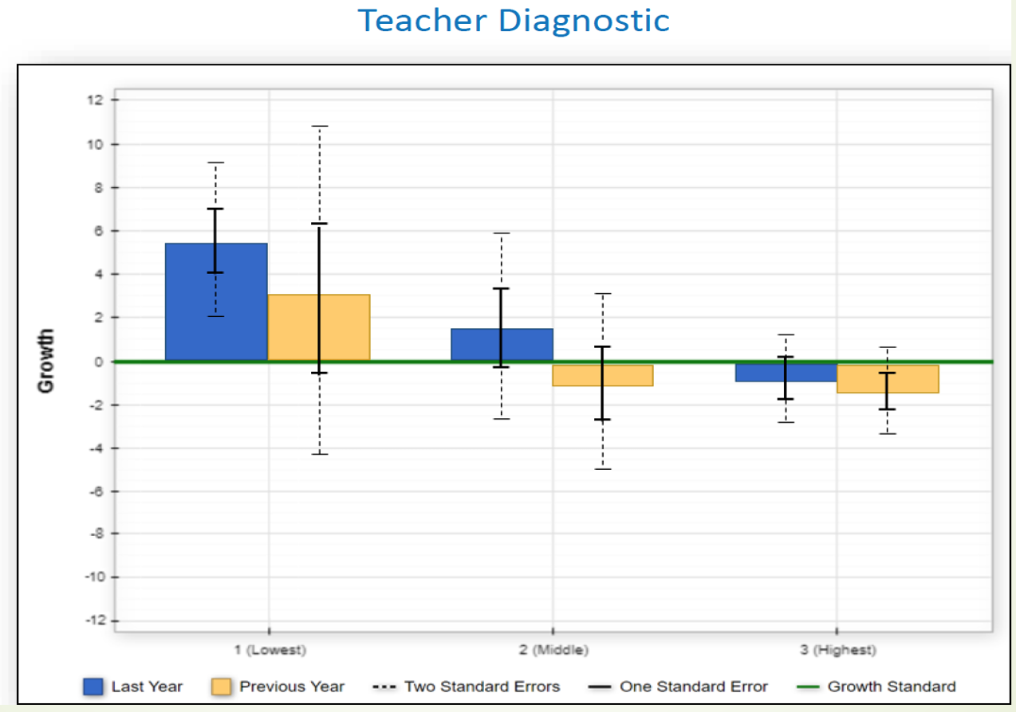
Scenario: We do
Mrs. Jackson’s Value-Added Data
Use your notetaker to record information about Mrs. Jackson’s value-added as we work through this together.
Notes:
Reviewing Mrs. Jackson’s Value-Added Data we are going to ask that you use your notetaker to analyze the data within this report.
As a reminder the blue bar is last year’s data and the gold bar is the previous year data.
Some questions that could be used to prompt teachers are:
Which groups of students are making growth?
Which groups of students are not making growth?
How is the trend overtime represented in this groups?
Then have participants briefly share out their analysis.

Slide 16
Data Coaching NoteTaker
 | Note Taker
What do you notice in the data? | At first glance the lowest tertile has significant growth for the current and previous year.
What patterns or trends are evidenced? | While students in all three tertiles made growth last year, the students in the highest tertile did not make as much growth as the other two tertiles for the current year.
Potential Contributing Factors: | Is the curriculum aligned to high standards? Is the teacher working on higher levels of DOK? What strategies are being used with each group?
What is missing or lacking? Are there other data you would like to see/review? | How are students performing on standards? Are any of these students identified? How many students are in each group?
Do you see something unusual or surprising that you would like to explore further? | How is she differentiating for groups of students in her class? How did she change her instruction last year for the mid-low students to make growth for the current year?
EVAAS Reports Flipchart Resource
Notes:
Referring back to the key questions within our notetaker here are some possible responses and additional questions that could be asked to prompt the teacher to analyze the data at a deeper level.
(Read through the chart)
Here is a link to an additional resource that may help you as you have conversations around Value-Added reports. You will find there are in many conversation starters and questions throughout the flipbook can provide support.
https://docs.google.com/presentation/d/1wYdULE7VTGAi4mdRZPnOsJGSC9AbuSSOhSk_NRhC05A/present
Link for Value-Added flipchat is on the slide for participants to access.

Slide 17
Summarizing Analyzing
Overarching Questions:
How is analyzing data important beyond HQSD?
Go back to your jamboard, think about where you have placed the various data sources? How might you adjust the Jamboard?
Notes:
I’m going to leave you with these two overarching questions as we move into “Planning” component:
How is analyzing data important beyond HQSD?
Go back to your jamboard, think about where you have placed the various data sources? How might you adjust the Jamboard?

Slide 18
Planning:
I can use trends and patterns within data sources to coach teachers to plan appropriate instruction for students.
Notes:
Another component of the Data Coaching Cycle is Planning, which also includes reflecting. Our focus is on how to use trends and patterns within data sources to coach teachers to plan appropriate instruction for students.

Slide 19
Planning in the Data Coaching Cycle
Notes:
How have you used data to coach teachers to plan for instruction and learning for their students? Please share a strategy or practice by unmuting or placing in the chat.

Slide 20
Using Data to Plan
What references are made to the use of data (HQSD and/or non HQSD sources) for the purposes of planning? OTES 2.0 Rubric
Example:
Notes:
As we think about the OTES 2.0 Rubric and what references are made to the use of data for the purposes of planning.
Link to rubric: https://education.ohio.gov/getattachment/Topics/Teaching/Educator-Evaluation-System/Ohio-s-Teacher-Evaluation-System/OTES-2-0/Ohio-Teacher-Performance-Evaluation-Rubric-OTES-2-0.pdf.aspx?lang=en-US
While use of data to plan may be in various areas of the rubric– it will be a significant focus in the instructional planning domain (focus for learning, knowledge of students). However, it does impact areas like– lesson delivery, etc.
Areas of the rubric that reference use of data:
Instructional Planning
> Focus for learning > Use of HQSD > at least two sources, plans for the facilitation of appropriate student data collection
> Knowledge of students > planning using student experiences, culture, and developmental characteristics (abilities, strengths, needs, talents, etc.)
Instruction and Assessment
> Lesson Delivery > Communication with students > communicating appropriate, needs-based, differentiated learning goals, expectations for mastery
> Lesson Delivery > Monitoring student understanding > clarifying content as he or she sees challenges
> Assessment of student learning > Use of assessments > analyzes patterns to measure targeted student learning, anticipate learning obstacles, modify instruction
> Assessment of student learning > Evidence of student learning > uses at least two sources of HQSD
Professionalism
> Professional Responsibilities > Communication and collaboration with colleagues > examine instructional practice and analyze patterns in student work and student data

Slide 21
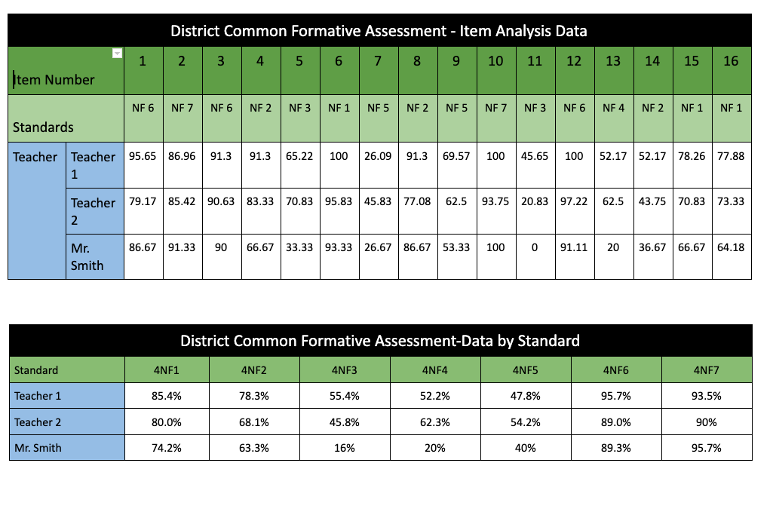
Scenario: You do
Mrs. Jackson’s Common Assessment Data
What do you notice?
Mrs. Jackson’s value-added diagnostic data
4th Grade Math Model Curriculum
Notes:
Here you see Mrs. Jackson’s value-added diagnostic and district-developed common assessment data. A 16-item assessment was given. Mrs. Jackson is on a team of 3 teachers. They all gave the same assessment with the same condition after teaching the same curriculum. This information is important because it could be referenced in the lesson plan analysis and in the coaching questions participants develop. Take a minute to look over the data. What do you notice?
Some responses may include:
Students in the highest tertile are not making required growth.
There are a number of items that large amounts of students are missing (#3).
Word problems seem to be challenging for students.
Students are performing well on NF 6, 7 +
Students are not performing well on NF3, 4, 5.
Data is showing that overtime, there is evidence that students in all groups are not making growth.
Is the teacher working through conceptual understanding based on the fact that modeling and reasoning questions are low?
The state data is nearly identical to local data.
The growth may tie to standards alignment and depth of knowledge.
Compare this to the OST data; this is showing the same thing.
Are students retaining the information over the long hall? How are students processing DOK?
Is this a teacher issue or perhaps a curriculum issue? Are the materials being used aligned, etc.?
Why are problems related to DOK 2 low? How are students performing on local benchmarks?
Mrs. Jackson has high performing students.
How is she differentiating for groups of students in her class?

Slide 22
Summary of Mrs. Jackson’s Data
Strengths:
Standard Areas:
Numbers and Operations- Fractions (NF) 6 and 7
Areas for Growth:
Standards
NF 3, 4, 5
Strengthen Conceptual and Higher Level Understanding of Content:
Depth of Knowledge (DOK) 2 Items
Modeling and Reasoning Items
Needs to focus on stretching groups of students
Notes:
This is a review of the data analysis from the analyzing section. Quickly highlight these areas as they will need to use this analysis in the next activity.
Participants could add any of this to the note taking document from slide 12.

Slide 23
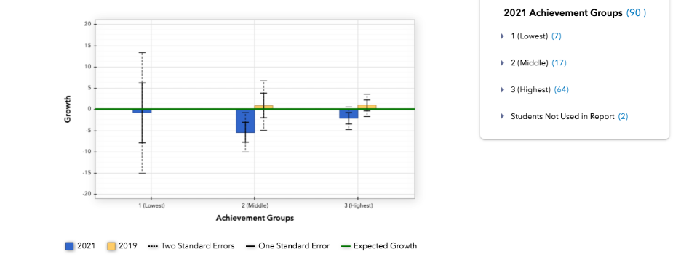
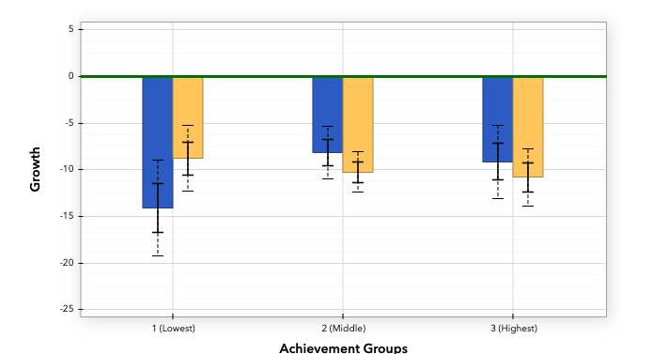
Data Coaching NoteTaker
 | Note Taker
What do you notice in the data? | Students in three of the three tertiles are not making the required growth in the most recent year.
What patterns or trends are evidenced? | Data is showing that overtime, there is evidence that students in all groups are not making growth. This is represented by trend data over previous years.
Potential Contributing Factors: | Is the curriculum aligned to high standards? Is the teacher working on higher levels of DOK? What strategies are being used with each group?
What is missing or lacking? Are there other data you would like to see/review? | How are students performing on standards? Are any of these students identified?
Do you see something unusual or surprising that you would like to explore further? | Mrs. Jackson has high performing students. How is she differentiating for groups of students in her class?
EVAAS Reports Flipchart Resource
Notes:
Referring back to the key questions within our notetaker here are some possible responses and additional questions that could be asked to prompt the teacher to analyze the data at a deeper level.
Note Taker
What do you notice in the data?
Students in three of the three tertiles are not making the required growth in the most recent year.
What patterns or trends are evidenced?
Data is showing that overtime, there is evidence that students in all groups are not making growth. This is represented by trend data over previous years.
Potential Contributing Factors:
Is the curriculum aligned to high standards? Is the teacher working on higher levels of DOK? What strategies are being used with each group?
What is missing or lacking? Are there other data you would like to see/review?
How are students performing on standards? Are any of these students identified?
Do you see something unusual or surprising that you would like to explore further?
Mrs. Jackson has high performing students.
How is she differentiating for groups of students in her class?
Here is a link to an additional resource that may help you as you have conversations around Value-Added reports. You will find there are in many conversation starters and questions throughout the flipbook can provide support.
https://docs.google.com/presentation/d/1wYdULE7VTGAi4mdRZPnOsJGSC9AbuSSOhSk_NRhC05A/present

Slide 24
Mrs. Jackson’s Lesson Plan
How is Mrs. Jackson using the data to plan her lesson?
What HQSD data sources are referenced in Mrs. Jackson’s lesson plan?
What non-HQSD data sources are referenced in Mrs. Jackson’s lesson plan?
What data sources may be missing that are available in your district?
How is she using what she learned, while reflecting on the data, to best plan to support student learning?
Access Mrs. Jackson's Full Lesson Plan
Notes:
Segway
People need to let go of HQSD as the be-all end all. How is the teacher using ALL data sources in this lesson plan?
The focus of this discussion is on the portion of the lesson that in pictured in the slide and p. 2 of the lesson plan (listing data sources). Participants may access the lesson plan beyond the scope of this training (for a deep dive; there are many different ways data is not used correctly, which can result in rich conversations), by clicking the link provided.
Depending upon group size, the questions can be discussed whole group or in breakout groups.
Overall notes for presenter- HQSD sources- Mrs. Jackson references VA projections and diagnostic reports — but the key is, how are these and other sources (i.e., item analysis from state and/or local data) being utilized to plan his lesson? If time permits they can access the full lesson and begin thinking about coaching questions they could develop.

Slide 25
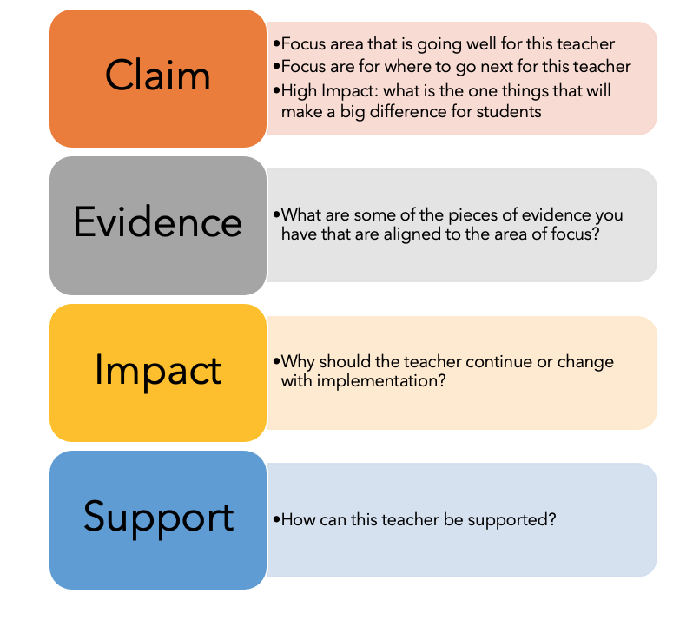
If you need to coach Mrs. Jackson, try the CEIS framework:
Coaching Mrs. Jackson
CEIS Document
Insert questions here
Insert questions here
Insert questions here
Insert questions here
Notes:
(Remind participants that the link is also on the Resource Document.)
The CEI framework is used in the OTES 2.0 credentialing training, so you may be familiar with it. The CEI process is one that is used not only in OTES 2.0, but it is used in other areas such as science where evidence is used to to provide supporting details when interpreting data during experiments and activities or in writing where a claim is made about a topic based upon observations and becomes the focus of the paragraph and the writing. Here we are using it as a coaching option of the reflective portion of the coaching process. The S was added to this tool so it can be used to think about the support for the teacher.
Review the your notetaking document and think of some questions you could create for each part of the CEIS framework.
RDL Trainers: With your training partner, role play. One person will be Mrs. Jackson. The other person will role play the role of the coach.
Use the CEI process outlined in the example.
C: I see you and your students have been using data to inform instruction. How is that going? What has gone well?
MS: .
C: Great. That’s important. How do you think that might help your students improve performance?
MS:
C: I agree. I think that will certainly help them and you and your should should continue with that! Yes, and where do you think you might improve your usage of data?
IS: I’m really not sure.
C: I know that you ____________. I see in your data ______________. What if you ___________________? Then, after our next check in, we can analyze those results and reflect on your next instructional steps (planning). How does that sound?

Slide 27
General Example, Using the CEIS framework:
Planning in the Data Coaching Cycle
Why is it important to use data to plan for your learners?
How did you use data to plan for your learners?
How might you use data to plan for your learners in future lessons?
How can I best support you in the use of data?
Notes:
If you are an OTES evaluator or instructional coach– this is a very quick reference guide you can use as a tool to support your coaching conversations around using data to plan. These questions are great to get the conversation started and then you can go deeper as needed.

Slide 28
Summarizing Planning
Overarching Questions:
How is planning with data important beyond HQSD?
Go back to your jamboard, think about where you have placed the various data sources? How might you adjust the Jamboard?
Notes:
Present question to participants. Allow them to revisit the jamboard to reassess placement of various data sources.
I’m going to leave you with these two overarching questions as we move into the next component.

Slide 29
Modifying:
I can coach teachers to modify instruction to meet student needs based on the ongoing collection and analysis of data.
Notes:
This section focuses on Modifying, which also includes reflecting.
Ask participants to share with a partner ways that they have used data to plan for instruction.
How have you used data to coach teacher to modify for instruction? Unmute or share in the chat.

Slide 30
Modifying in the Data Coaching Cycle
Notes:
Another component of the Data Coaching Cycle is Modifying. How are you utilizing the information learned to coach teachers to modify instruction for their students?

Slide 31
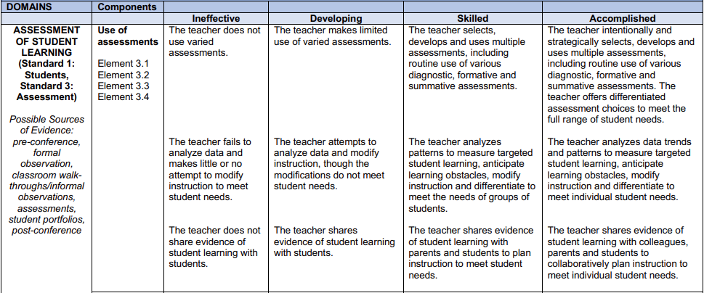
Modifying in the Data Coaching Cycle
Notes:
We used Assessment of student learning to dig deeper into the data conversation. Through the next few slides you will see how different data sources were used to analyze data trends and patterns to modify instruction.

Slide 32
What is modifying based on data?
It is:
Using data throughout the year to inform your instruction during a lesson.
Using ALL data formative and summative to adjust instruction during the lesson based on students needs.
It is NOT:
A student learning objective
Only relying on HQSD
Only using data to plan a lesson

Slide 33
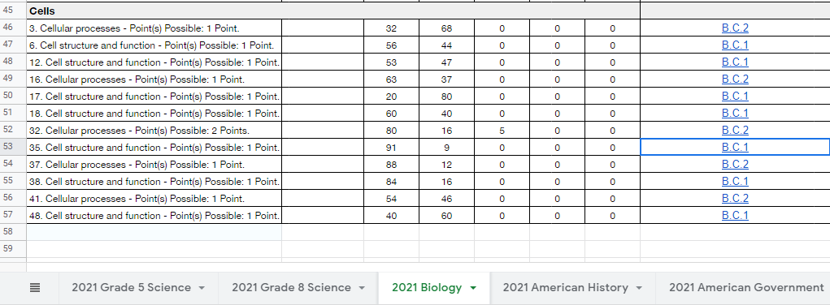
Modifying Instruction:
Notes:
As a data coach, you should remember to prompt teachers to use their reflection. When you begin conversations around modifying instruction or responding to the data, it helps to start with what they noticed (ask about gaps or trends). Then prompt the teacher to ask why or identify a root cause.
In this example, the teacher decided to dive into the released items to see exactly what the questions are asking their students to be able to know/do.
Caution: When looking at item level analysis, it is important to look at the bigger picture. Although #35 shows 91% getting the problem incorrect, there are 7 questions on this standard. It can be beneficial to deeply investigate individual areas of concern, but it also should be realized this is only one question and we are not promoting modifying an entire curriculum based upon one question.

Slide 34
Modifying Instruction:
This requires students to:
Know cell structure and function
It also requires student to analyze what a change in cellular structure might imply, an analysis of how structure informs function.
Notes:
Skimming through the released items, the teacher began to find another pattern.
The questions were asking students to know more than only the cell parts and functions.
Students were being asked to think about their relationship and analyze, given real world scenarios, and what would happen if the cell parts were missing or just not there due to the type of cell in question.
Student were also asked to consider how the omission of cell parts due to cell type might impact cellular processes.

Slide 35
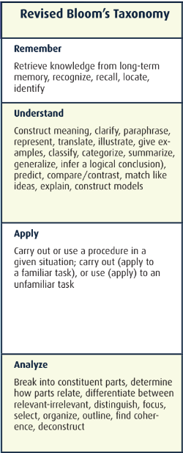
Modifying Instruction:
Next, after examining the item analysis data, sample test questions, and current lesson plans with learning targets and success criteria that aligned to this standard, the teacher determined that he was not scaffolding higher levels of cognition.
He could not merely ask students to recall and compare cell structure and function.
He had to help students analyze their importance. He will need to provide scaffolds that help students determine what might happen when cellular structures vary (are present or not) and how that impacts the function within a variety of authentic tasks.
After additional item analysis, he found this to be the case for other standards as well.
Notes:
Give participants time to review slide:
This changed the focus of the teachers lab work. The teacher wanted to create multiple entry points for students, based on formative assessment, which would allow the students who were ready to move beyond analysis of cellular structure and function to move on to creation and evaluation within the scientific process. Those who were struggling to get to the analysis would need a variety of supports and scaffolds that the teacher wanted to make available to everyone in the class.
Building in frequent formative checks throughout the lessons that aligned to the performance level descriptions and cognitive rigor matrix helped him have more clarity around both assessment and lesson modification.

Slide 36
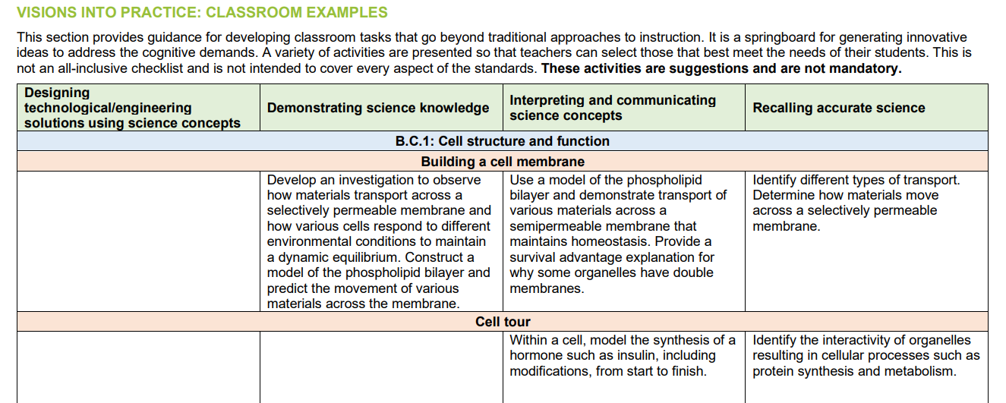
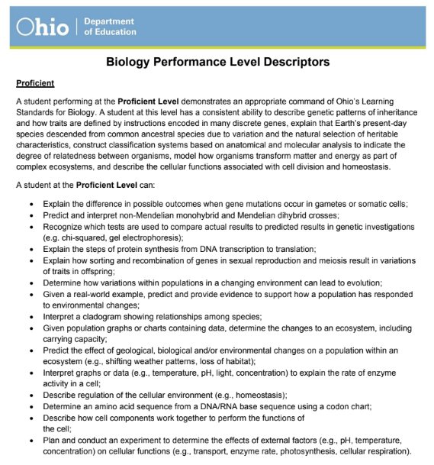
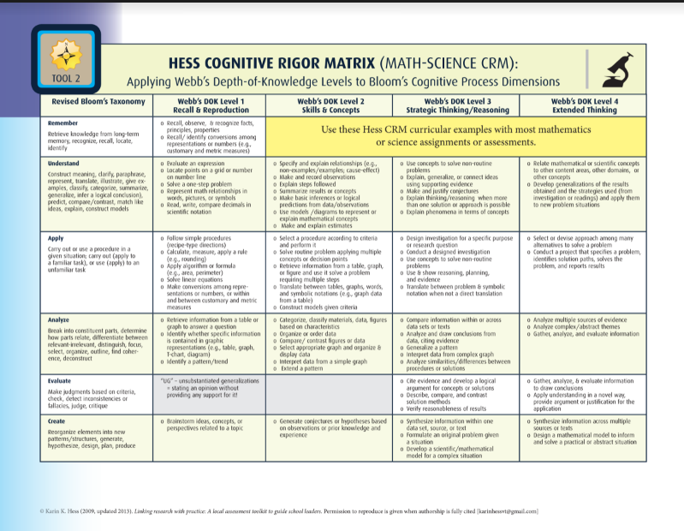
Modifying Instruction:
The teacher decided to review:
the Visions into Practice, Classroom examples from the Ohio Learning Standards and Model Curriculum
as well as Hess’ Cognitive Rigor Matrices, and
Performance Level Descriptors for Biology
to help inform instructional adjustments.
Notes:
As a data coach, it is important to coach teachers to consider selecting high quality materials to improve or adjust their practice.
Read the slide:
(resource links for the screenshots on the slide)
OLS and Model Curriculum: http://education.ohio.gov/getattachment/Topics/Learning-in-Ohio/Science/Ohios-Learning-Standards-and-MC/SciFinalStandardsMC060719.pdf.aspx?lang=en-US
Hess’ Cognitive Rigor Matrix for Science: https://drive.google.com/drive/folders/1XJ9CeJWNkhCNuYa1BSfa-rhiaaPv5CGq
Biology: PLD: https://drive.google.com/file/d/1fSzSj3fBTvd1wpxLdxWf9ZuMEC5prdp8/view?usp=sharing
The proficient level descriptor for this standard asks students to describe… this is something the teacher will consider building into his lesson. (Describe how cell components work together to perform the functions of
the cell)

Slide 37
Modifying Instruction:
Examine the Restart Readiness data from an 8th grade Science teacher.
What questions would you ask the educator around this data?
As the coach - how would you ask the teacher how they modified their instruction based on the data?
Notes:
(The snip is a link to the data. Remind participants that the link is also on the Resource Document.)
Have participants pair up or small groups and look at the data and develop questions they would ask and determine how they would use the data to modify instruction. If time allows - have participants have a mock conversation around the data.
Side Note: bottom link is to all the data - we pulled apart the data to just one section to use and dig deeper into. Conversation could be to look at all data to help educators understand how to focus on the most important part to modify to support student learning.
Click on the image to view the data.
Link to Data: https://docs.google.com/presentation/d/e/2PACX-1vQzahW83xA_Pp_3uKesNAPGST0mx3RH9ARSwXovA6gQ1NkEydYwavOT5z57MtbfJSwapn8n3yJsDPWR/pub?start=false&loop=false&delayms=3000
Link to All Data: https://drive.google.com/file/d/1erRuyHzKxTGlgiypJfWDULfLeLYwkNcQ/view?usp=sharing

Slide 38
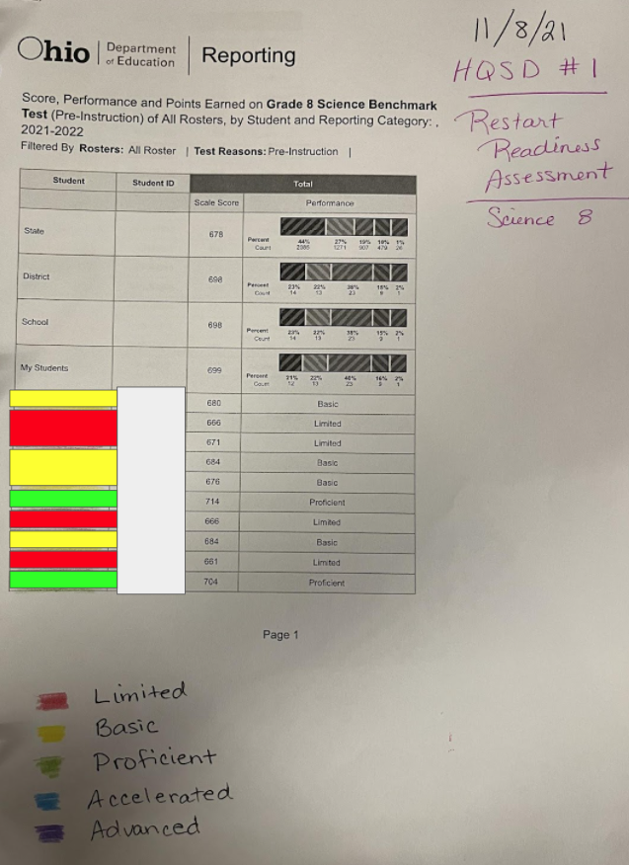
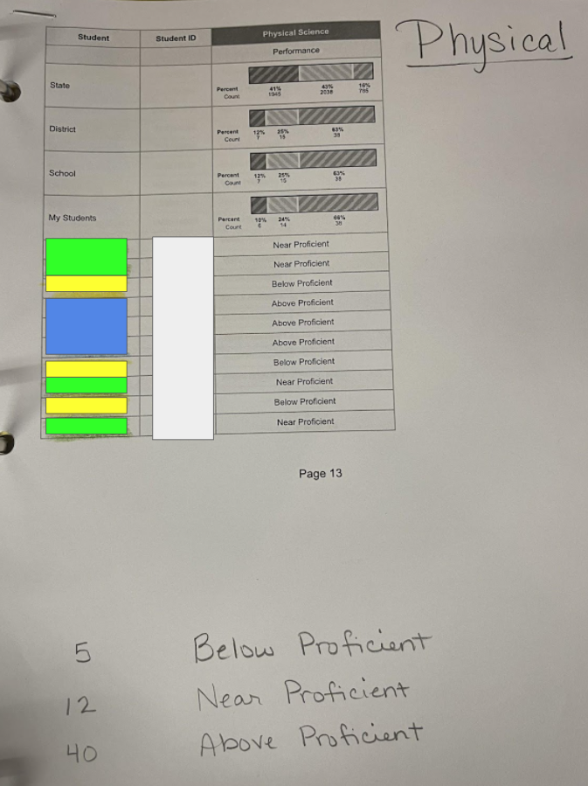
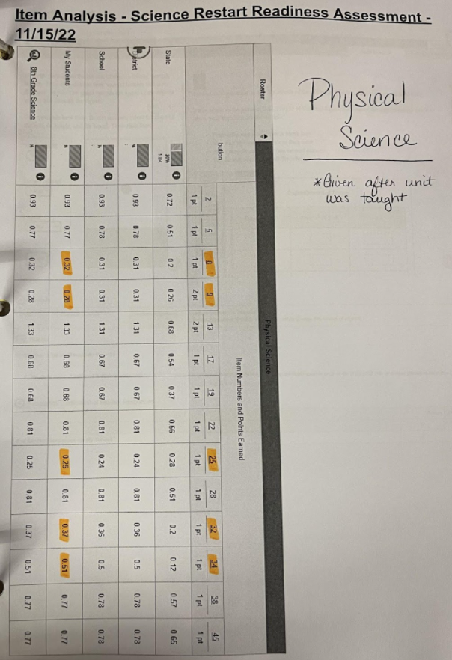
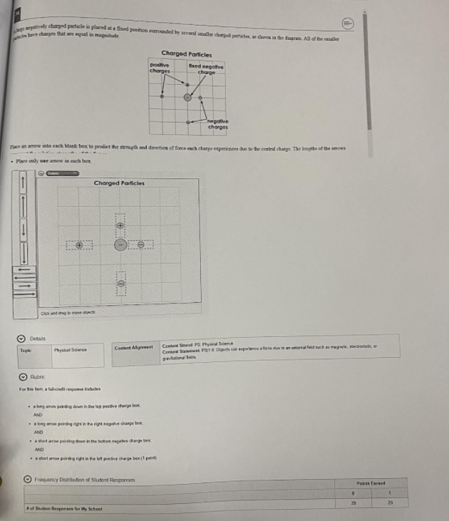
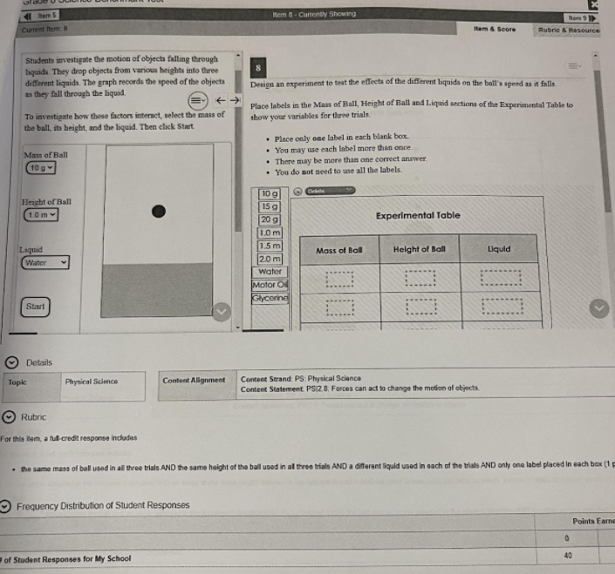
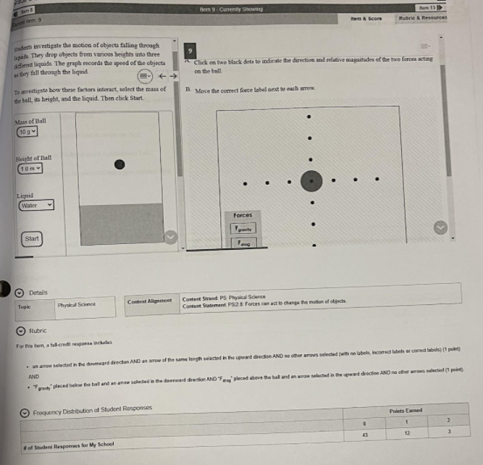
Modifying Instruction:
Restart Readiness Data 8th grade Science - Physical Science section
Notes:
Have participants pair up or small groups and look at the data and develop questions they would ask and determine how they would use the data to modify instruction. If time allows - have participants have a mock conversation around the data.
Click on the image to view the data.
Link to Data: https://docs.google.com/presentation/d/e/2PACX-1vQzahW83xA_Pp_3uKesNAPGST0mx3RH9ARSwXovA6gQ1NkEydYwavOT5z57MtbfJSwapn8n3yJsDPWR/pub?start=false&loop=false&delayms=3000
Link to All Data: https://drive.google.com/file/d/1erRuyHzKxTGlgiypJfWDULfLeLYwkNcQ/view?usp=sharing

Slide 39
Summary of Mrs. Osman’s Data
Strengths:
Standard Areas:
Physical Science
Areas for Growth:
Standards
PS.1 & 2
Strengthen Conceptual and Higher Level Understanding of Content:
Depth of Knowledge (DOK) 2 Items
Interpreting and Communicating Science Concepts (30-50%)
Demonstrating Science Knowledge (10-25%)
Needs to focus on visualize aids/ graphic organizers
Restart Readiness Data 8th grade Science - Physical Science section
Notes:
Here is a quick summary of the data already analyzed by the teacher, resources that could be used during this discussion are ODE Science Standards, Blue Print, Performance Level Descriptors, and Model Curriculum.
Link to Data: https://docs.google.com/presentation/d/e/2PACX-1vQzahW83xA_Pp_3uKesNAPGST0mx3RH9ARSwXovA6gQ1NkEydYwavOT5z57MtbfJSwapn8n3yJsDPWR/pub?start=false&loop=false&delayms=3000
Link to All Data: https://drive.google.com/file/d/1erRuyHzKxTGlgiypJfWDULfLeLYwkNcQ/view?usp=sharing
Science Standards - https://education.ohio.gov/getattachment/Topics/Learning-in-Ohio/Science/Ohios-Learning-Standards-and-MC/SciFinalStandardsMC060719.pdf.aspx?lang=en-US
Blue Print - https://oh-ost.portal.cambiumast.com/-/media/project/client-portals/ohio-ost/pdf/2014q3/test_specifications_g8_science.pdf

Slide 40
Modifying Instruction:
The Video show an example of how the teacher used the restart readiness assessment.
Prior to this section the teacher discussed how in the past her value added data showed she struggled with limited and basic students.
What did you notice about the conversation in the video?
What additional questions could you ask to support this teacher?
Notes:
Watch the video as a whole group video will play from 5:02 - 9:15 (could cut it at 8:17 if short on time)
Have groups share out what they noticed about the conversation in the video. (unmute or chat bar)
Share out to create a deeper understanding of how you can use the data differently to modify instruction.
Parts to pull out of the video to make sure participants understand:
Note: This is a top teacher who uses data daily to inform her instruction. How might this conversation be different with a newer teacher or a teacher not comfortable with data? What questions/ steps might you need to take to have a richer conversation on how they can use the data to modify their instruction?
Whole video with VA and Restart Readiness Conversation - https://youtu.be/arFogiAH698

Slide 41
Modifying Instruction:
Follow-up:
How are you using the data to make decisions that support students who are scoring the lowest?
What steps are being taken to modify instruction?
How are you using data to make decisions to offer extension to students who have mastered the standard?
What steps are being taken to modify instruction?
If a teacher is struggling with modifying a few questions to help guide:
If data is telling you some students are struggling, how are you going to modify instruction to address their needs? Mastered concept?
What are your next steps?
What goal(s) would you like to accomplish through modify your instruction? How do you hope to see the data change after modification?
Notes:
In follow-up coaching sessions, be sure to ask about results.
Read the bullets
Also, share some example responses (scaffolding, adding background knowledge, or providing authentic tasks and opportunities to design or create)

Slide 42
Modifying Instruction:
Scaffold:
Hands on
Tool
Unit
Restart
Readiness
Assessment
Formative Assessments
to monitor progress impact of instructional changes
Next Unit:
Create Visuals & Graphic aids
Scaffold:
Visual Aid
& Graphic
Instructional Change
Additional Instructional Changes as needed
Notes:
This teacher gave her restart readiness assessment after her first unit, analyzed the data, and realized that there were additional scaffolds and supports such as hands on manipulatives, graphic organizers, and visuals that some of her limited and basic students needed to make connections to prior knowledge. She rotated groups with sometimes slightly different prompts and questions so those students who were scoring in the advanced level could also benefit from the scaffolds that were provided. She used the questions to make connections to high levels of cognition such as and real world situations.
The teacher then had the stations rotate so that each student could experience multiple ways to engage with the content.
Throughout this unit she would formatively assess students to see if they were making progress and to help her make decisions around future instructional accommodations.
Finally, when planning for the next unit, she was sure to include the types of instructional scaffolds that were helping students in her current unit.

Slide 43
Summarizing Modifying
Overarching Questions:
How is modifying instruction using data important beyond HQSD?
Go back to your jamboard, think about where you have placed the various data sources? How might you adjust the Jamboard?

Slide 44
Today’s Learning Targets
Big Idea
Use the reflect-plan-modify cycle to coach teachers in their usage of data to improve instructional practice and student learning.
Analyzing | Planning | Modifying
I can analyze patterns and data sources to coach teachers. | I can use trends and patterns within data sources to coach teachers to plan appropriate instruction for students. | I can coach teachers to modify instruction to meet student needs based on the ongoing collection and analysis of data.
Reflection
If you would like to make a copy of the presentation
Notes:
Where are you on today’s learning targets? Conduct a poll Zoom or the chat box using each “I Can…” statement.
Just to reiterate, all of these slides and materials will be made available to you, so that you can utilize these resources in training situations with districts (in full or part). You will find some slides are hidden throughout so you can modify and add extension activities that best fit the needs of your audience. Again, the training may be abbreviated or extended as needed or as time permits.
Link to the “forced copy” of the entire presentation:
https://docs.google.com/presentation/d/1QWYbLWbDZpr5KqL-Dsm0ONeCcWx52vK1rSePsVs4z08/copy

Slide 45
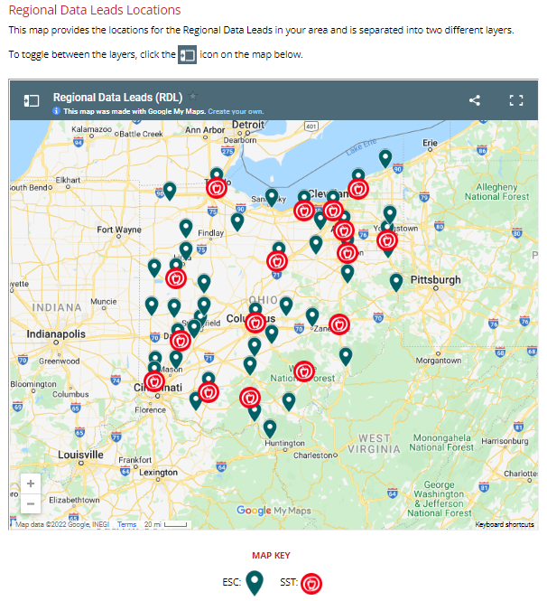
Questions?
For additional support, consider contacting a Regional Data Lead in your area.
Notes:
https://education.ohio.gov/Topics/Data/Regional-Data-Leads

Slide 46
The Big Idea:
I can use the analyze-plan-modify cycle to coach teachers in their usage of data to improve instructional practice and student learning.
Notes:
This section is an extension that includes the big idea: using analyze-plan-modify cycle to coach teachers in their usage of data to improve instructional practice and student learning.

Slide 47
Using Data to Modify an Art Classroom
Art teacher uses pre-assessment data to modify her lessons to create flexible student groups to meet them at their entry point.
This process is completed after every project.
Watch one small portion of the conversation.
Notes:
Here is an art teacher who uses pre-assessment data to modify her lessons to create flexible student groups to meet them at their entry point.
This process is completed after every project.
We are going to watch one small portion of the conversation
As you watch the video think about the questions that are being asked to coach the teacher, but also consider some other questions that could be asked.
Video begins at 6:55 to 10:39

Slide 48
Questions for data conversations around modifying in
Questions to Coach a High School Art Teacher
What are you currently using to collect student data?
How do you use your data?
What process or method do you use to identify next steps based on student needs/strengths?
How do you scaffold your lessons based on identified needs from your data?
How are you determining prior knowledge?
Are you creating or using pre-assessments?
How do you offer extensions to students who are very strong in particular areas?
How are you giving students feedback and opportunities to respond to that feedback?
Share some examples of how you have responded to student needs with a variety of approaches.
What ways do you monitor student progress or other student data?
How do you monitor standard alignment?
How do you know when to scaffold?
How do you know where to begin instruction when students may be lacking background knowledge?
Do you use your data to inform student choice or voice? If not, how might you?
Are you grouping students? If so, how do you use data to inform student groups?
How are you using data to help students take ownership of their learning and become challenged, prepared, and empowered?
Notes:
More questions to consider - how teacher responded

Slide 49
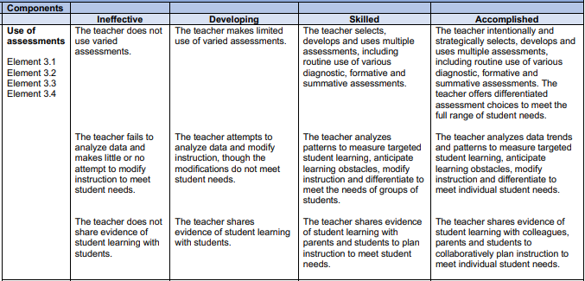
Connection to OTES 2.0
Connections to OTES 2.0
Teacher could be in Skilled or Accomplished based on if this is a one and done or if she is continuously using the data to modify her instruction.
Notes:
Rubric a connection to OTES - ART
Teacher could be in Skilled or Accomplished based on if this is a one and done or if she is continuously using the data to modify her instruction.

Slide 50
Using Data to Modify an Intervention Specialist Classroom
Izzie Interventionist is a middle school intervention specialist.
An Intervention Specialist focuses on the data used to support Jenny, an 8th grade student.
Collaboration including the student, the Intervention Specialist and other professionals contribute to developing an appropriate action plan to support the needs of Jenny.
Notes:
Pull a coaching question and data to look at - IS
https://docs.google.com/document/d/1W4rRsssiuBIw6c0aoGxrRe3zQieCmYKhFSky-0RL7Yc/edit?usp=sharing

Slide 51
Using Data to Modify an Intervention Specialist Classroom
How are you collecting evidence of progress monitoring data during the small group instructional time?
Describe how you will combine progress monitoring data from Read Naturally with data from small group instruction.
With what frequency will you revisit to analyze data?
What adaptations/revisions have you made or can you anticipate may be necessary?
What targeted interventions will you provide as it relates to Jenny’s Suggested Area of Focus from the MAP benchmark: Informational Text: Key Ideas & Details?
How do you communicate evidence of learning with students, parents and colleagues?
Notes:
Here are more questions to consider depending on how the teacher responds.

Slide 52
Connection to OTES 2.0
Ineffective | Developing | Skilled | Accomplished
The teacher does not use high-quality student data to develop measurable and developmentally appropriate student growth goal(s). | The teacher uses one source of high-quality student data and attempts to analyze patterns to develop measurable and developmentally appropriate student growth goal(s). The analysis may be incomplete or inaccurate. | The teacher correctly and thoroughly analyzes patterns in at least two sources of high-quality student data to develop measurable and developmentally appropriate student growth goal(s) and monitors student progress toward goals. | The teacher correctly and thoroughly analyzes trends and patterns in at least two sources of high-quality student data to develop measurable and developmentally appropriate student growth goal(s) and monitors student progress toward goals. The teacher plans for the facilitation of developmentally appropriate student data collection and strategies to assist in student goal setting and progress monitoring.
Student was involved in planning for her IEP setting goals and monitoring progress therefore this teacher would be accomplished. They are using the data to modify her instruction throughout.
Evidence to Support OTES 2.0 Rating: NWEA MAP data used to identify big picture instructional focus (Informational Text: Key Ideas & Details). Additional resources/assessments used to more granularly identify student specific goals and action plans - MAZE, ORF, Core Phonics. Supplemental tools utilized for regular progress monitoring of determined goals (Read Naturally Word Warm-Ups, informal observations during small group work).
Notes:
OTES - IS
Teacher would be rated Skilled or Accomplished based on if the student is part of the planning for their student goal setting and progress monitoring.

Slide 53
Additional Resources
High School Art - Video, Resources
Intervention Specialist - Resources
MS General Education - Resources
Notes:
Here is a list of additional scenarios along with additional questions.

